Slide 1
CPSC 583 Expert Systems Design Theory
Dr. Anand Panangadan
apanangadan@fullerton.edu

Slide 2
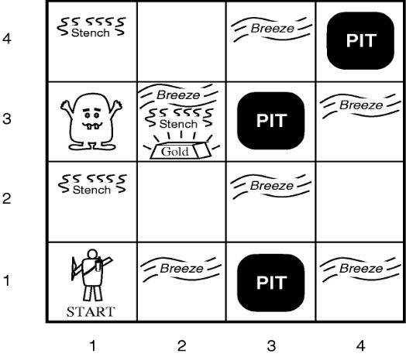
Propositional logic review
Symbolic logic for manipulating propositions
Develop a propositional logic system to decide where to move
What variables?
How to represent:
S11 = None ⇒ S12 = Safe ∧ S21 = Safe
How many rules?

Slide 3

Predicate Calculus/First Order Logic (FOL)
In addition to propositions, FOL provides:
Variables
Represent objects in the world
x, y
Functions
father-of(Mary) = John
Function input and output are objects
Predicates
Represent relationships between objects
father-of (Mary, John)
father-of (x, y) $⇒$child(y,x)
Predicate is either True or False

Slide 4
Building a FOL sentence
Constant symbols correspond to objects (“individuals”) in the Universe
E.g., Today, Mary
Convention: begin with a Capital letter
Variable symbols represent one of the objects
E.g., x, y, z
Convention: use small letters
Function symbols
E.g., mother-of (Bill); maximum-of (x,y)

Slide 5
Building a FOL sentence
A function expression consists of a function symbol of arity n, followed by n terms
mother-of(mother-of(joe))
maximum(maximum(7, 18), add_one(18))
Arity: number of input parameters
A term is either a constant, variable, or function expression.
color_of(house_of(neighbor(Joe)))
house_of(x)

Slide 6
Building a FOL sentence
A term is either a constant or variable
Can also be a function expression
color_of(house_of(neighbor(Joe)))
house_of(x)

Slide 7
Building a FOL sentence
Predicate symbols
Represent a specific relationship between objects
An atomic sentence is a predicate symbol of arity n, followed by n terms
father-of (Mary, John)
The truth values, True and False, are also atomic sentences.

Slide 8
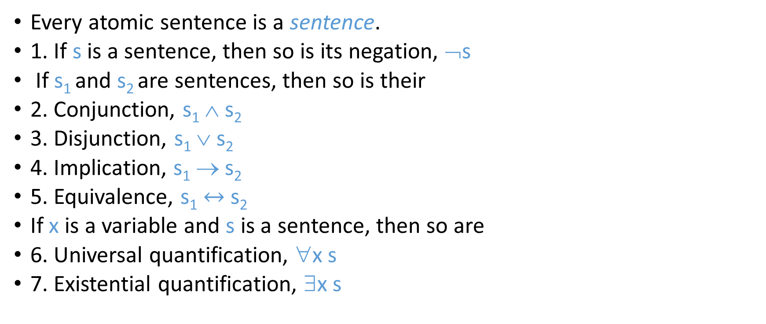
Building a FOL sentence
Every atomic sentence is a sentence.
1. If s is a sentence, then so is its negation, ¬s
If s₁ and s₂ are sentences, then so is their
2. Conjunction, s₁ ∧ s₂
3. Disjunction, s₁ ∨ s₂
4. Implication, s₁ → s₂
5. Equivalence, s₁ $↔$ s₂
If x is a variable and s is a sentence, then so are
6. Universal quantification, ∀x s
7. Existential quantification, ∃x s

Slide 9
Difference between sentences and terms
Logic sentences evaluate to True or False
Functions evaluate to objects
Functions are not atomic sentences
∃x mammal(x) ∧ lays-eggs(x)
Predicate
symbol
term (constant)

Slide 10
Quantifiers
Universal quantification
∀x P(x) means that P holds for all values of x in the domain associated with that variable
E.g., ∀x dolphin(x) → mammal(x)
Existential quantification
∃x P(x) means that P holds for some value of x in the domain associated with that variable
E.g., ∃ x mammal(x) ∧ lays-eggs(x)
Permits one to make a statement about some object without naming it

Slide 11
Universal quantifiers
“All students are smart”
Define predicates: student(x), smart(x)
∀x student(x)∧smart(x)
or
∀x student(x) → smart(x)
Universal quantifiers are often used with → (implies) to form “rules”:
∀x student(x) → smart(x) means “All students are smart”
Universal quantification is rarely used to make statements about every individual in the world:
∀x student(x)∧smart(x) means “Everyone in the world is a student and is smart”

Slide 12
Existential quantifiers
“There is a student who is smart”
Predicates: student(x), smart(x)
∃x student(x) ∧ smart(x)
or
∃x student(x) → smart(x)
Existential quantifiers are usually used with ∧(and) to specify a list of properties about an individual:
∃x student(x) ∧ smart(x) means “There is a student who is smart”
A common mistake:
∃x student(x) → smart(x) to represent “There is a student who is smart”
Why? (what happens when there is a person who is not a student?)

Slide 13
Quantifier Scope
Switching the order of universal quantifiers does not change the meaning:
∀x∀y P(x,y) ↔ ∀y∀x P(x,y)
Can switch the order of existential quantifiers:
∃x∃y P(x,y) ↔ ∃y∃x P(x,y)
Switching the order of universals and existentials does change meaning:
∀x ∃f food(f) ∧ likes (x,f) “Everybody likes some food”
∃f ∀x food(f) ∧ likes (x,f) “There is a (one specific) food that everyone likes”

Slide 14

Connections between All and Exists
Rewrite sentences involving ∀ and ∃ using De Morgan’s laws:
∀x P(x) ↔ $¬$∃x $¬$P(x)
∃x P(x) ↔ $¬$∀x $¬$P(x)

Slide 15
Translating English to FOL
Every gardener likes the sun.
∀x gardener(x) → likes(x,Sun)
You can fool some of the people all of the time.
∃x ∀t person(x) ∧time(t) → can-fool(x,t)
You can fool all of the people some of the time.
∀x ∃t (person(x) → time(t) ∧can-fool(x,t))
∀x (person(x) → ∃t (time(t) ∧can-fool(x,t)))
All purple mushrooms are poisonous.
∀x (mushroom(x) ∧ purple(x)) → poisonous(x)
No purple mushroom is poisonous.
¬∃x purple(x) ∧ mushroom(x) ∧ poisonous(x)
∀x (mushroom(x) ∧ purple(x)) → ¬poisonous(x)
There are exactly two purple mushrooms.
∃x ∃y mushroom(x) ∧ purple(x) ∧ mushroom(y) ∧ purple(y) ^ ¬(x=y) ∧ ∀z (mushroom(z) ∧ purple(z)) → ((x=z) ∨ (y=z))
Clinton is not tall.
¬tall(Clinton)
Every city has a dogcatcher who has been bitten by every dog in town.
∀T ∃C ∀D city(C) → ( dogcatcher(C,T) ∧ (dog(D) ∧ lives-in (D, T) → bit (D, C)) )

Slide 16
Translating English to FOL
Predicates
tall(x)
gardener(x)
likes(x, y)
mushroom(x)
purple(x)
poisonous(x)
teacher(x)
time(t)
can-fool(x,t)
wears-shorts(x)
wears-tshirt(x)

Slide 17
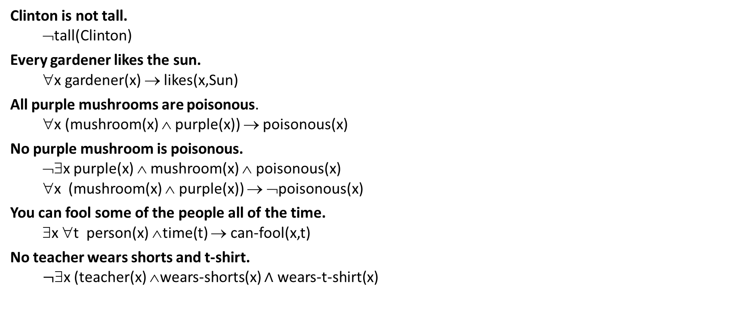
Translating English to FOL
Clinton is not tall.
¬tall(Clinton)
Every gardener likes the sun.
∀x gardener(x) → likes(x,Sun)
All purple mushrooms are poisonous.
∀x (mushroom(x) ∧ purple(x)) → poisonous(x)
No purple mushroom is poisonous.
¬∃x purple(x) ∧ mushroom(x) ∧ poisonous(x)
∀x (mushroom(x) ∧ purple(x)) → ¬poisonous(x)
You can fool some of the people all of the time.
∃x ∀t person(x) ∧time(t) → can-fool(x,t)
No teacher wears shorts and t-shirt.
$¬$∃x (teacher(x) ∧wears-shorts(x) $∧$ wears-t-shirt(x)

Slide 18
Proofs in propositional logic
How to prove conclusion is valid?
Truth table
Every case where the premise is true, conclusion must also be true
Proof by rules of inference
Resolution refutation algorithm
How to prove conclusion is invalid?
Truth table
Show one case where the premise is true, conclusion must also be true
Proof by rules of inference
Resolution refutation algorithm

Slide 19
Proofs in propositional logic
How to prove conclusion is valid?
Truth table
Every case where the premise is true, conclusion must also be true
Proof by rules of inference
Resolution refutation algorithm
How to prove conclusion is invalid?
Truth table
Show one case where the premise is true, conclusion must also be true
Proof by rules of inference
Resolution refutation algorithm

Slide 20
Proofs in predicate logic
How to prove conclusion is valid?
Truth table
Every case where the premise is true, conclusion must also be true
Proof by rules of inference
Resolution refutation algorithm
How to prove conclusion is invalid?
Truth table
Show one case where the premise is true, conclusion must also be true
Proof by rules of inference
Resolution refutation algorithm

Slide 21
Proof by Resolution Refutation
Does Premise → Conclusion?
Convert all premise sentences to CNF
Add the negated conclusion
Repeatedly apply rule of resolution until
Derive FALSE (contradiction): Conclusion is valid
Can’t apply any more: Conclusion cannot be proved
Proof by contradiction

Slide 22
Rules of inference
For FOL

Slide 23

AND elimination
P ∧ Q
$∴$P
$∴$Q
Example:
president(Obama)$∧$ vicepresident(Biden)
$∴$president(Obama)
$∴$vicepresident(Biden)

Slide 24

AND introduction
Q
P
$∴$P$∧$Q
Example:
$$\text{president}\text{(}\text{Obama}\text{)}$$
$$\text{vicepresident}\text{(}\text{Biden}\text{)}$$
$∴$president(Obama)$∧$ vicepresident(Biden)

Slide 25
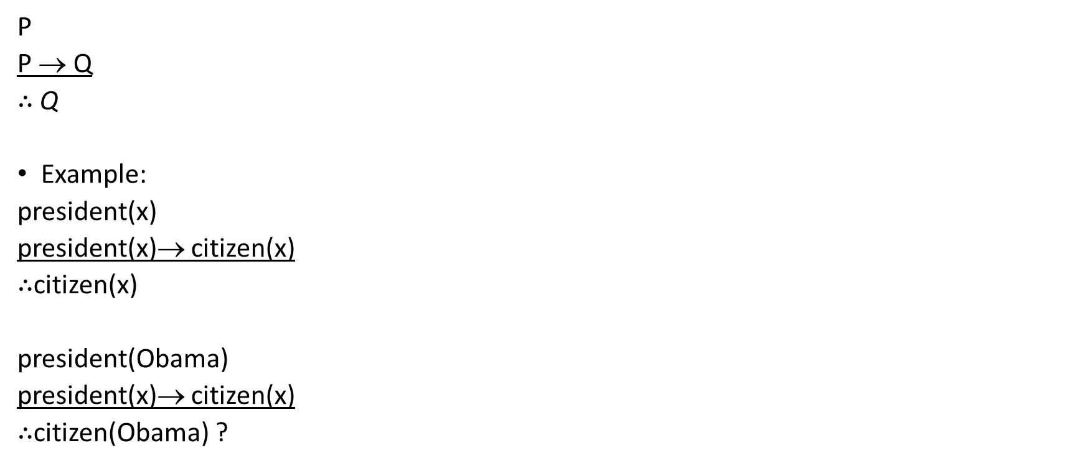
Modus ponens
P
P → Q
$∴$Q
Example:
president(x)
president(x)→ citizen(x)
$∴$citizen(x)
president(Obama)
president(x)→ citizen(x)
$∴$citizen(Obama) ?

Slide 26
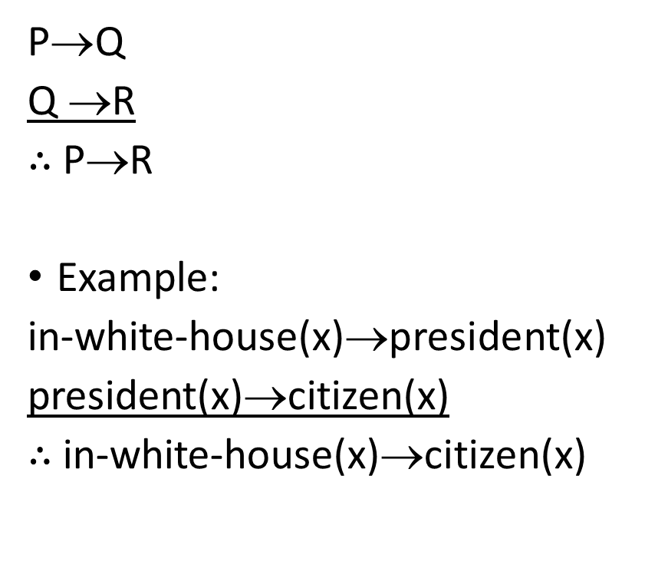
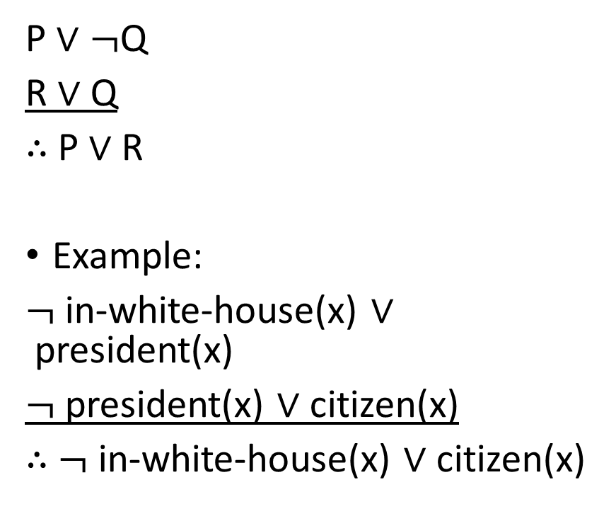
Resolution
$\text{P}∨¬$Q
R $∨$ Q
$∴$P $∨$R
Example:
$¬$ in-white-house(x) $∨$president(x)
$¬$ president(x) $∨$ citizen(x)
$∴$ $¬$ in-white-house(x) $∨$citizen(x)
$\text{P}\text{→}$Q
Q →R
$∴$P→R
Example:
in-white-house(x)→president(x)
president(x)→citizen(x)
$∴$ in-white-house(x)→citizen(x)

Slide 27
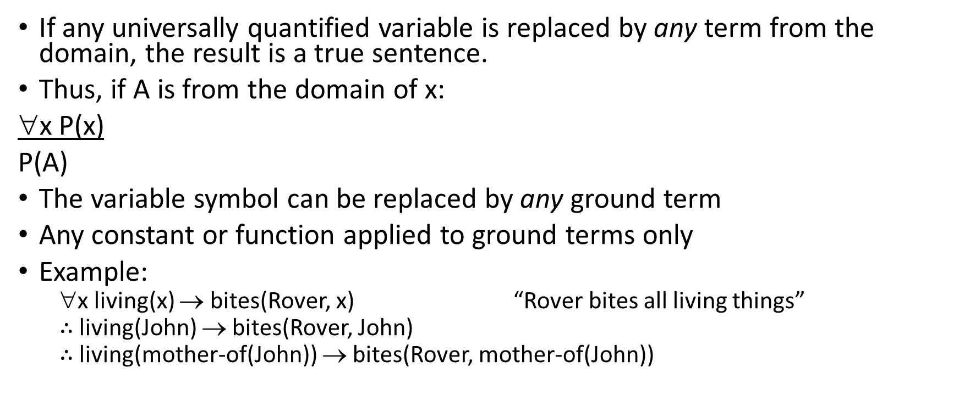

Universal instantiation ($∀$)
If any universally quantified variable is replaced by any term from the domain, the result is a true sentence.
Thus, if A is from the domain of x:
∀x P(x)
P(A)
The variable symbol can be replaced by any ground term
Any constant or function applied to ground terms only
Example:
∀x living(x) → bites(Rover, x) “Rover bites all living things”
$∴$ living(John) → bites(Rover, John)
$∴$ living(mother-of(John)) → bites(Rover, mother-of(John))

Slide 28
Example
If it is sunny on a particular day, then the sun shines on the window. If the sun shines on the window on any day, the curtains are closed. The curtains are not closed today.
Is it sunny today?
Use predicates:
sunny(x)
window-shines(x)
curtains-closed(x)

Slide 29
Example
If it is sunny on a particular day, then the sun shines on the window. If the sun shines on the window on any day, the curtains are closed. The curtains are not closed today.
Is it sunny today?
Premise
∀x sunny (x)→ window-shines (x)
∀x window-shines (x) → curtains-closed(x)
¬ curtains-closed (Today)
Conclusion?:
sunny (Today)
Use universal instantiation and unit resolution:
sunny (Today) → window-shines (Today)
window-shines (Today) → curtains-closed (Today)
¬ curtains-closed (Today)

Slide 30
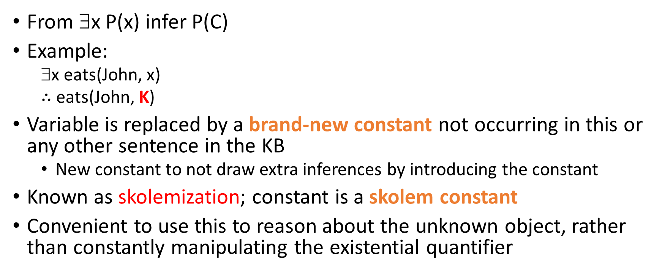
Existential instantiation (existential elimination)
From ∃x P(x) infer P(C)
Example:
∃x eats(John, x)
$∴$ eats(John, K)
Variable is replaced by a brand-new constant not occurring in this or any other sentence in the KB
New constant to not draw extra inferences by introducing the constant
Known as skolemization; constant is a skolem constant
Convenient to use this to reason about the unknown object, rather than constantly manipulating the existential quantifier

Slide 31
Existential generalization (existential introduction)
If P(C) is true, then ∃x P(x) is inferred.
Example
eats(John, Rice) ⇒ ∃x eats(John, x)
All instances of the given constant symbol are replaced by the new variable symbol
Note that the variable symbol cannot already exist anywhere in the expression

Slide 32
Connections between All and Exists
Rewrite sentences involving ∀ and ∃ using De Morgan’s laws:
∀x P(x) ↔ $¬$∃x $¬$P(x)
∃x P(x) ↔ $¬$∀x $¬$P(x)

Slide 33
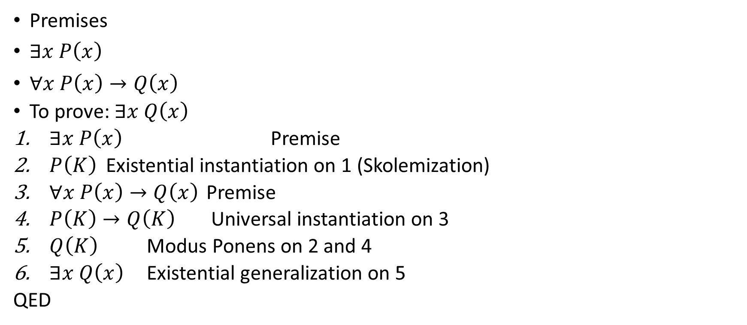
Example proof
Premises
$∃x P\left(x\right)$
$∀x P\left(x\right)→Q\left(x\right)$
To prove: $∃x Q\left(x\right)$
$∃x P\left(x\right)$ Premise
$P\left(K\right)$Existential instantiation on 1 (Skolemization)
$∀x P\left(x\right)→Q\left(x\right)$ Premise
$P\left(K\right)→Q\left(K\right)$ Universal instantiation on 3
$Q\left(K\right)$ Modus Ponens on 2 and 4
$∃x Q\left(x\right)$ Existential generalization on 5
QED

Slide 34
Automatic theorem proving
A proof procedure is a combination of an inference rule and an algorithm for applying that rule to a set of logical expressions to generate new sentences.
Proof by resolution

Slide 35
Key concepts
Sentence
Interpretation
Proposition, term, function, atom
Unification and mgu
Proofs in logic

Slide 36
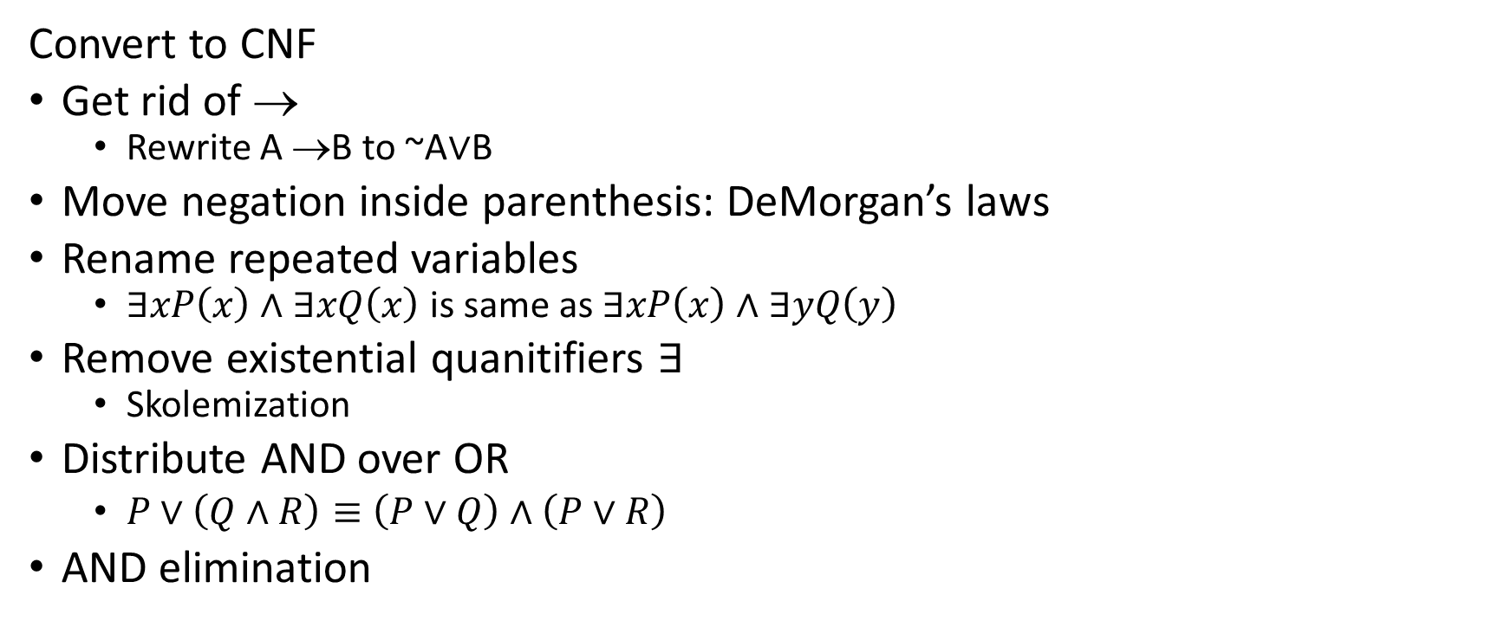
Proof by Resolution Refutation
Convert to CNF
Get rid of →
Rewrite A →B to ~A$∨$B
Move negation inside parenthesis: DeMorgan’s laws
Rename repeated variables
$∃xP\left(x\right)∧∃xQ\left(x\right)$ is same as $∃xP\left(x\right)∧∃yQ\left(y\right)$
Remove existential quanitifiers $∃$
Skolemization
Distribute AND over OR
$P∨\left(Q∧R\right)≡\left(P∨Q\right)∧\left(P∨R\right)$
AND elimination

Slide 37
Example
Premises
All dogs bark
Anyone who has cats will not have mice
A light sleeper will not have anything which barks
John has either a cat or a dog
Conclusion?
If John is a light sleeper, then John does not have any mice

Slide 38
Example
Predicates
Dog(x): “x is a dog”
Cat(x): “x is a cat”
Mouse(x): “x is a mouse”
Bark(x): “x barks”
Sleeper(x): “x is a light sleeper”
Have(x,y): “x has y”

Slide 39
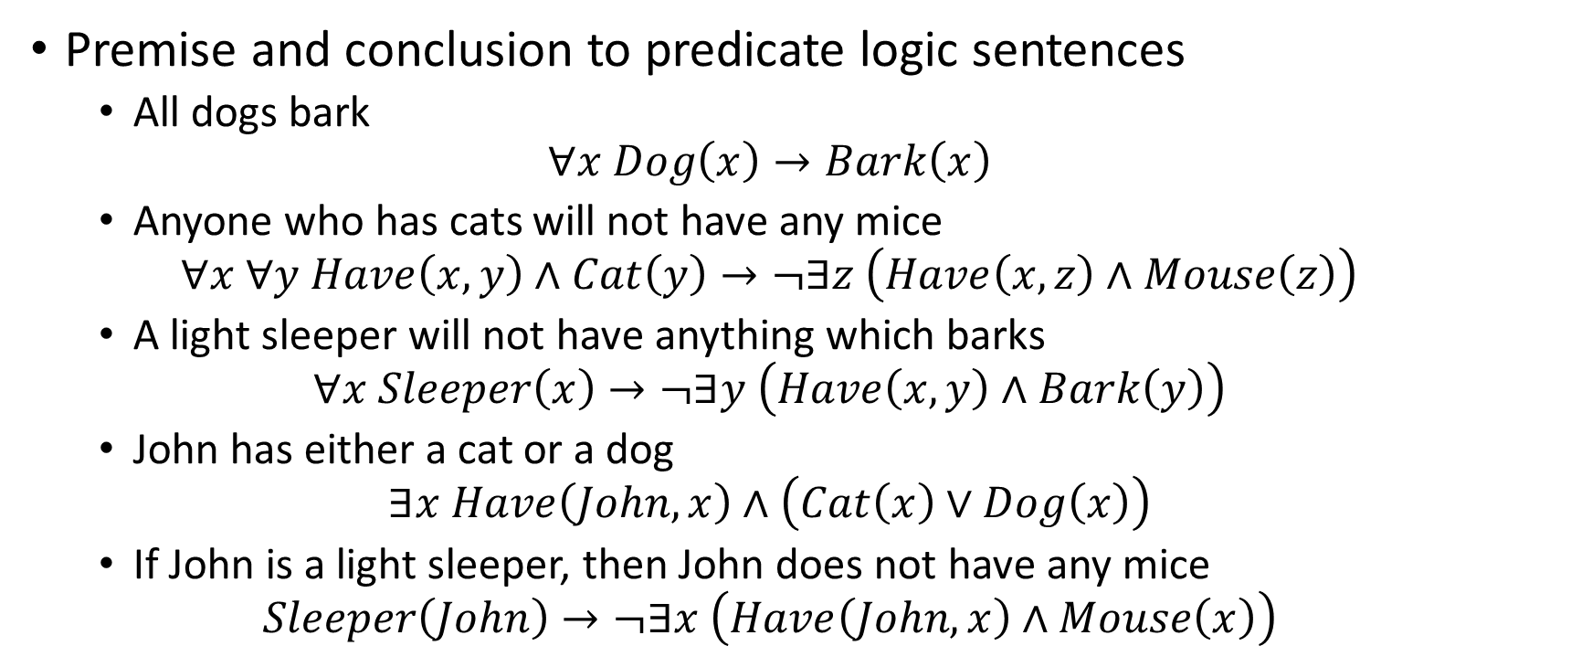
Example
Premise and conclusion to predicate logic sentences
All dogs bark
$$∀x Dog\left(x\right)→Bark\left(x\right)$$
Anyone who has cats will not have any mice
$$∀x ∀y Have\left(x,y\right)∧Cat\left(y\right)→¬∃z \left(Have\left(x,z\right)∧Mouse\left(z\right)\right)$$
A light sleeper will not have anything which barks
$$∀x Sleeper\left(x\right)→¬∃y \left(Have\left(x,y\right)∧Bark\left(y\right)\right)$$
John has either a cat or a dog
$$∃x Have\left(John,x\right)∧\left(Cat\left(x\right)∨Dog\left(x\right)\right)$$
If John is a light sleeper, then John does not have any mice
$$Sleeper\left(John\right)→¬∃x \left(Have\left(John,x\right)∧Mouse\left(x\right)\right)$$

Slide 40

Example
Convert to CNF form
$∀x Dog\left(x\right)→Bark\left(x\right)$
$∀x ¬Dog\left(x\right)∨Bark\left(x\right)$

Slide 41
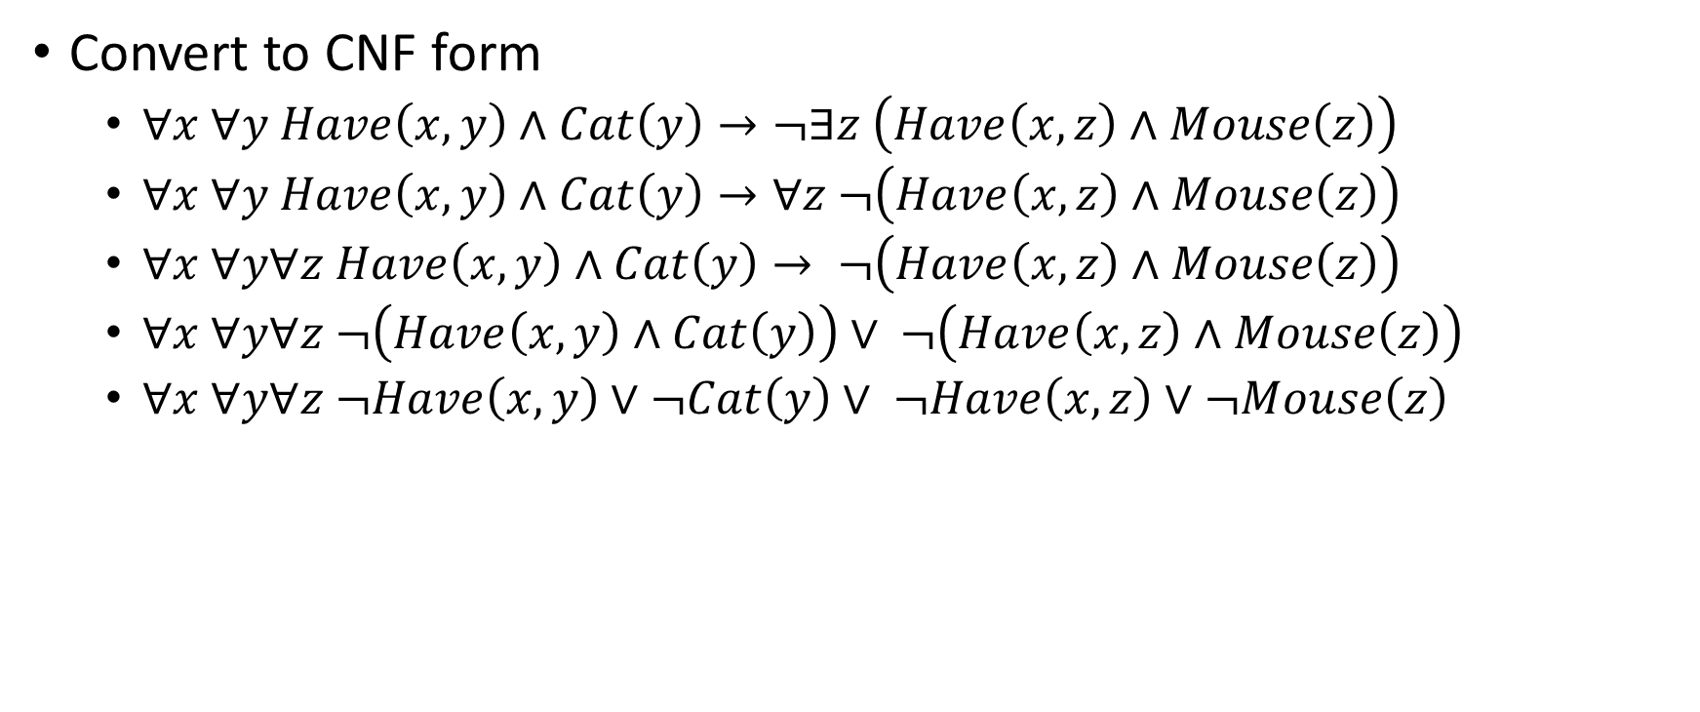
Example
Convert to CNF form
$∀x ∀y Have\left(x,y\right)∧Cat\left(y\right)→¬∃z \left(Have\left(x,z\right)∧Mouse\left(z\right)\right)$
$∀x ∀y Have\left(x,y\right)∧Cat\left(y\right)→∀z ¬\left(Have\left(x,z\right)∧Mouse\left(z\right)\right)$
$∀x ∀y∀z Have\left(x,y\right)∧Cat\left(y\right)→ ¬\left(Have\left(x,z\right)∧Mouse\left(z\right)\right)$
$∀x ∀y∀z ¬\left(Have\left(x,y\right)∧Cat\left(y\right)\right)∨ ¬\left(Have\left(x,z\right)∧Mouse\left(z\right)\right)$
$∀x ∀y∀z ¬Have\left(x,y\right)∨¬Cat\left(y\right)∨ ¬Have\left(x,z\right)∨¬Mouse\left(z\right)$

Slide 42

Example
Convert to CNF form
$∀x Sleeper\left(x\right)→¬∃y \left(Have\left(x,y\right)∧Bark\left(y\right)\right)$
$∀x Sleeper\left(x\right)→∀y ¬\left(Have\left(x,y\right)∧Bark\left(y\right)\right)$
$∀x∀y Sleeper\left(x\right)→¬Have\left(x,y\right)∨¬Bark\left(y\right)$
$∀x∀y ¬Sleeper\left(x\right)∨¬Have\left(x,y\right)∨¬Bark\left(y\right)$

Slide 43

Example
Convert to CNF form
$∃x Have\left(John,x\right)∧\left(Cat\left(x\right)∨Dog\left(x\right)\right)$
$Have\left(John,K_{1}\right)∧\left(Cat\left(K_{1}\right)∨Dog\left(K_{1}\right)\right)$ Skolemization
$Have\left(John,K_{1}\right)$
$Cat\left(K_{1}\right)∨Dog\left(K_{1}\right)$

Slide 44
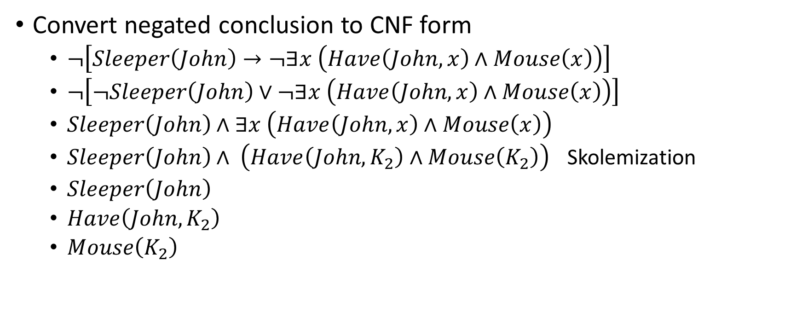
Example
Convert negated conclusion to CNF form
$¬\left[Sleeper\left(John\right)→¬∃x \left(Have\left(John,x\right)∧Mouse\left(x\right)\right)\right]$
$¬\left[¬Sleeper\left(John\right)∨¬∃x \left(Have\left(John,x\right)∧Mouse\left(x\right)\right)\right]$
$Sleeper\left(John\right)∧∃x \left(Have\left(John,x\right)∧Mouse\left(x\right)\right)$
$Sleeper\left(John\right)∧ \left(Have\left(John,K_{2}\right)∧Mouse\left(K_{2}\right)\right)$ Skolemization
$Sleeper\left(John\right)$
$Have\left(John,K_{2}\right)$
$Mouse\left(K_{2}\right)$

Slide 45
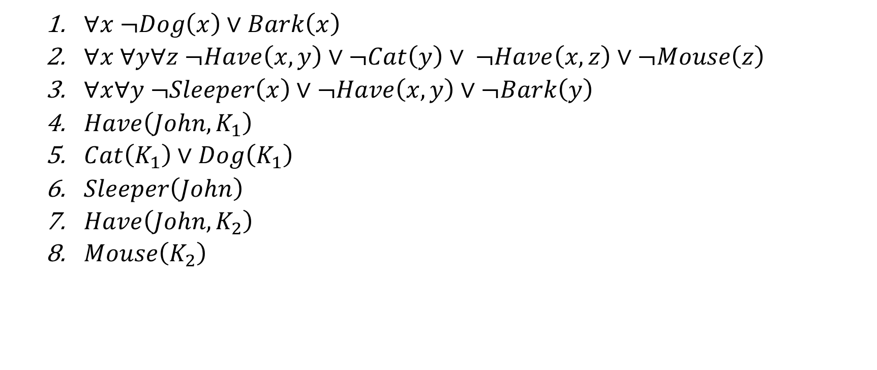
Resolution refutation
$∀x ¬Dog\left(x\right)∨Bark\left(x\right)$
$∀x ∀y∀z ¬Have\left(x,y\right)∨¬Cat\left(y\right)∨ ¬Have\left(x,z\right)∨¬Mouse\left(z\right)$
$∀x∀y ¬Sleeper\left(x\right)∨¬Have\left(x,y\right)∨¬Bark\left(y\right)$
$Have\left(John,K_{1}\right)$
$Cat\left(K_{1}\right)∨Dog\left(K_{1}\right)$
$Sleeper\left(John\right)$
$Have\left(John,K_{2}\right)$
$Mouse\left(K_{2}\right)$

Slide 46
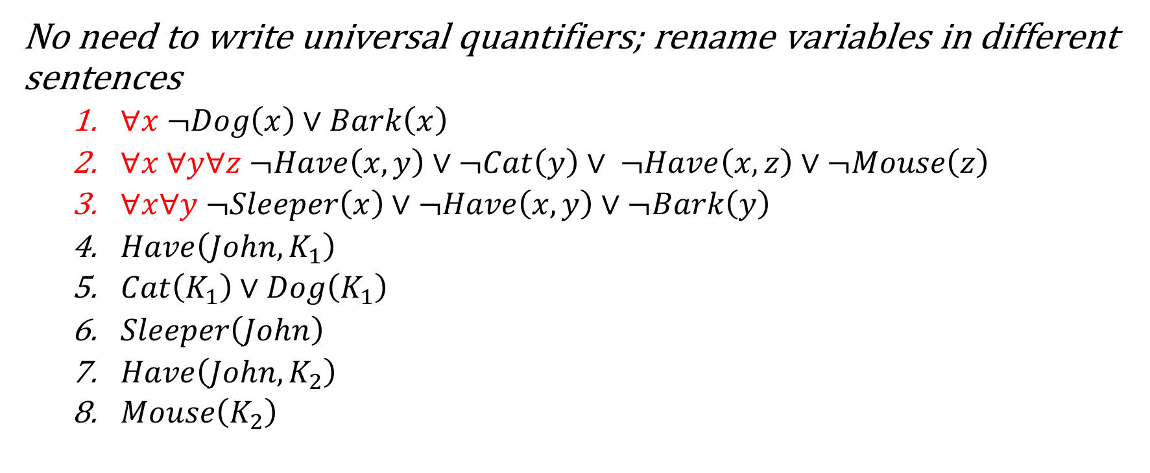
Resolution refutation
No need to write universal quantifiers; rename variables in different sentences
$∀x ¬Dog\left(x\right)∨Bark\left(x\right)$
$∀x ∀y∀z ¬Have\left(x,y\right)∨¬Cat\left(y\right)∨ ¬Have\left(x,z\right)∨¬Mouse\left(z\right)$
$∀x∀y ¬Sleeper\left(x\right)∨¬Have\left(x,y\right)∨¬Bark\left(y\right)$
$Have\left(John,K_{1}\right)$
$Cat\left(K_{1}\right)∨Dog\left(K_{1}\right)$
$Sleeper\left(John\right)$
$Have\left(John,K_{2}\right)$
$Mouse\left(K_{2}\right)$

Slide 47
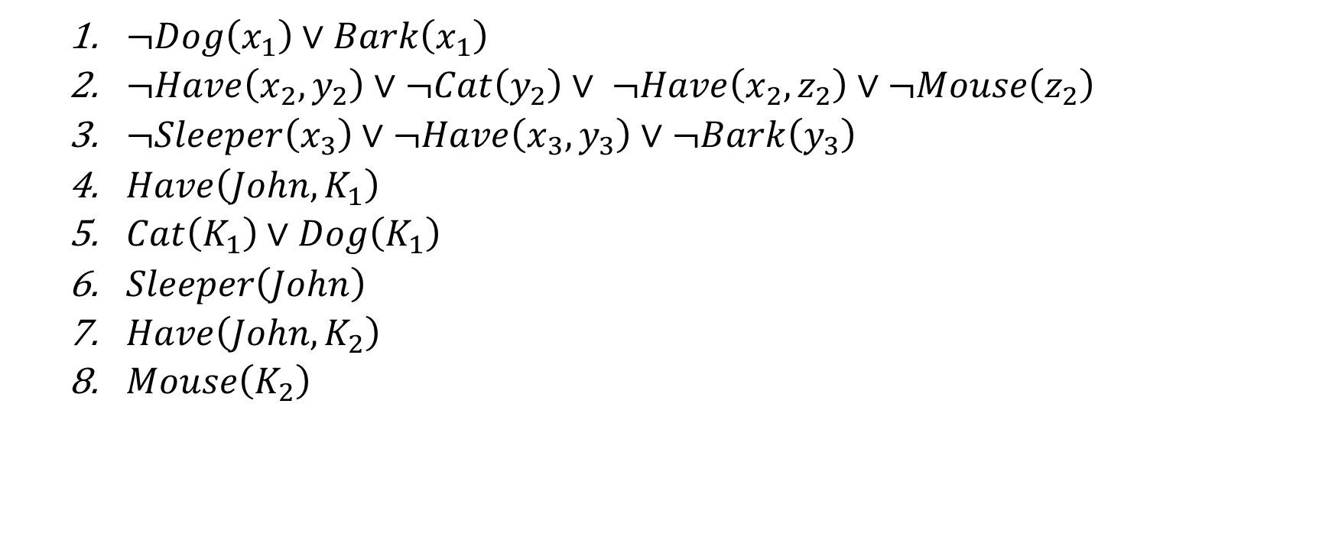
Resolution refutation
$¬Dog\left(x_{1}\right)∨Bark\left(x_{1}\right)$
$¬Have\left(x_{2},y_{2}\right)∨¬Cat\left(y_{2}\right)∨ ¬Have\left(x_{2},z_{2}\right)∨¬Mouse\left(z_{2}\right)$
$¬Sleeper\left(x_{3}\right)∨¬Have\left(x_{3},y_{3}\right)∨¬Bark\left(y_{3}\right)$
$Have\left(John,K_{1}\right)$
$Cat\left(K_{1}\right)∨Dog\left(K_{1}\right)$
$Sleeper\left(John\right)$
$Have\left(John,K_{2}\right)$
$Mouse\left(K_{2}\right)$

Slide 48
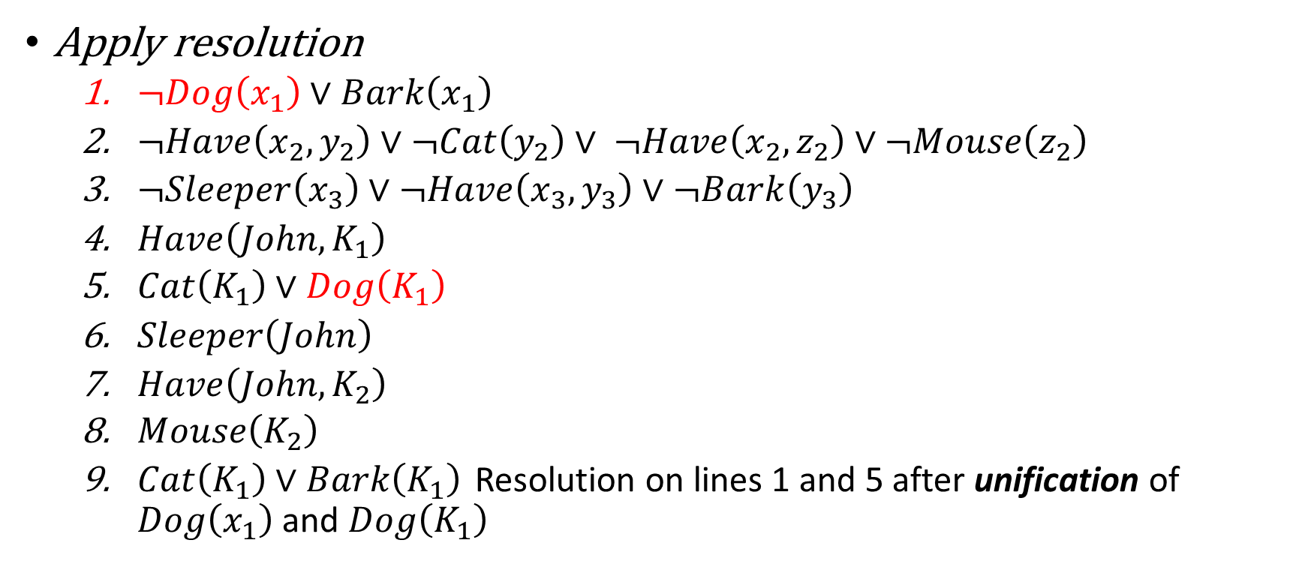
Resolution refutation
Apply resolution
$¬Dog\left(x_{1}\right)∨Bark\left(x_{1}\right)$
$¬Have\left(x_{2},y_{2}\right)∨¬Cat\left(y_{2}\right)∨ ¬Have\left(x_{2},z_{2}\right)∨¬Mouse\left(z_{2}\right)$
$¬Sleeper\left(x_{3}\right)∨¬Have\left(x_{3},y_{3}\right)∨¬Bark\left(y_{3}\right)$
$Have\left(John,K_{1}\right)$
$Cat\left(K_{1}\right)∨Dog\left(K_{1}\right)$
$Sleeper\left(John\right)$
$Have\left(John,K_{2}\right)$
$Mouse\left(K_{2}\right)$
$Cat\left(K_{1}\right)∨Bark\left(K_{1}\right)$ Resolution on lines 1 and 5 after unification of $Dog\left(x_{1}\right)$ and $Dog\left(K_{1}\right)$

Slide 49
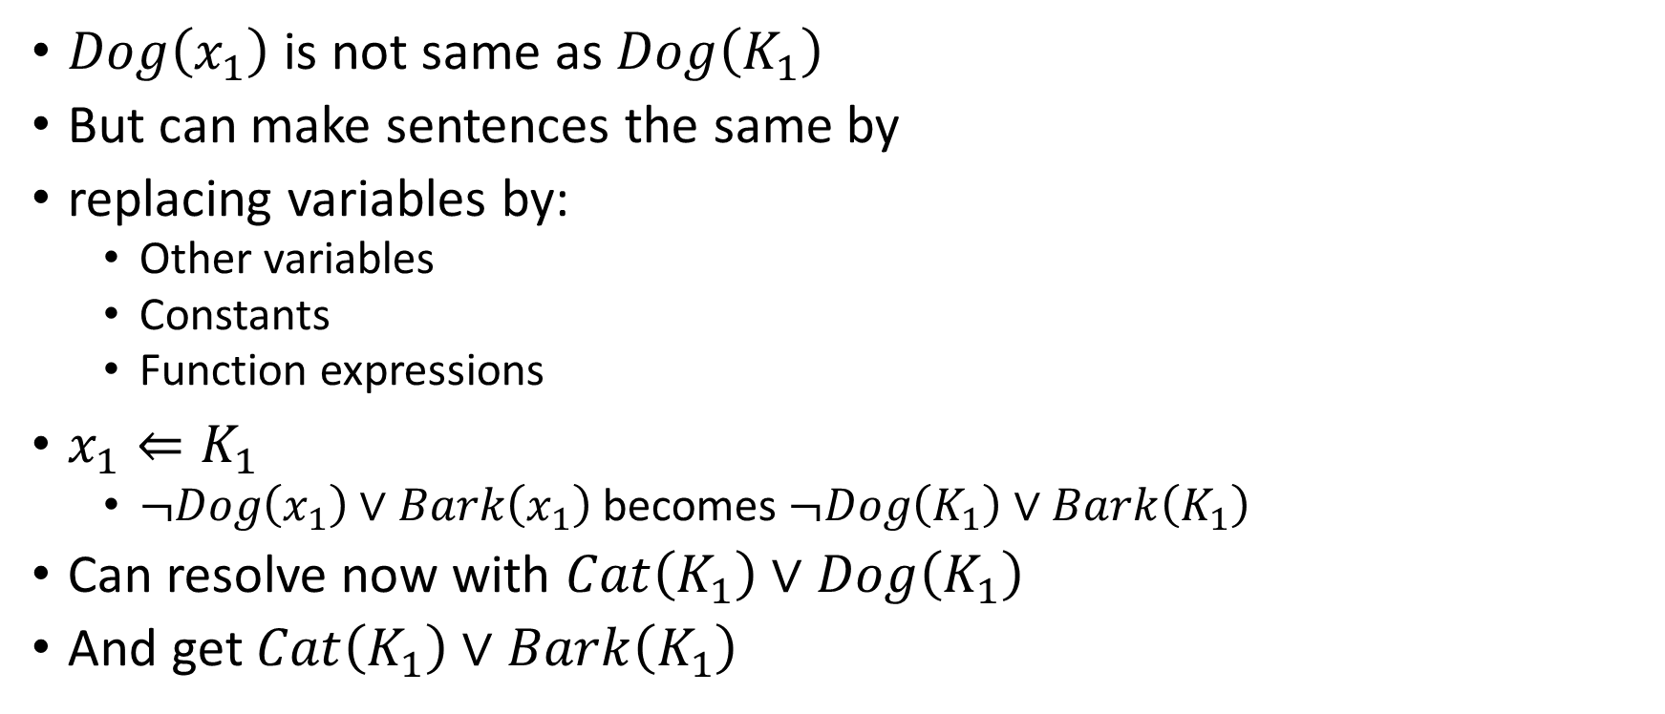
Unification
$Dog\left(x_{1}\right)$ is not same as $Dog\left(K_{1}\right)$
But can make sentences the same by
replacing variables by:
Other variables
Constants
Function expressions
$x_{1}⇐K_{1}$
$¬Dog\left(x_{1}\right)∨Bark\left(x_{1}\right)$ becomes$¬Dog\left(K_{1}\right)∨Bark\left(K_{1}\right)$
Can resolve now with $Cat\left(K_{1}\right)∨Dog\left(K_{1}\right)$
And get $Cat\left(K_{1}\right)∨Bark\left(K_{1}\right)$

Slide 50
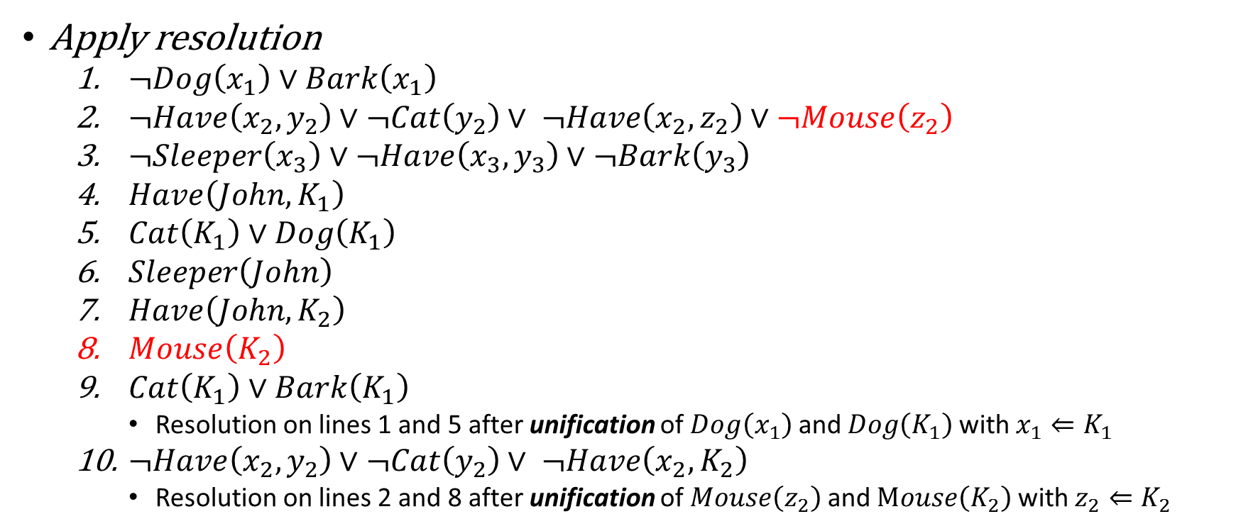
Resolution refutation
Apply resolution
$¬Dog\left(x_{1}\right)∨Bark\left(x_{1}\right)$
$¬Have\left(x_{2},y_{2}\right)∨¬Cat\left(y_{2}\right)∨ ¬Have\left(x_{2},z_{2}\right)∨¬Mouse\left(z_{2}\right)$
$¬Sleeper\left(x_{3}\right)∨¬Have\left(x_{3},y_{3}\right)∨¬Bark\left(y_{3}\right)$
$Have\left(John,K_{1}\right)$
$Cat\left(K_{1}\right)∨Dog\left(K_{1}\right)$
$Sleeper\left(John\right)$
$Have\left(John,K_{2}\right)$
$Mouse\left(K_{2}\right)$
$Cat\left(K_{1}\right)∨Bark\left(K_{1}\right)$
Resolution on lines 1 and 5 after unification of $Dog\left(x_{1}\right)$ and $Dog\left(K_{1}\right)$ with $x_{1}⇐K_{1}$
$¬Have\left(x_{2},y_{2}\right)∨¬Cat\left(y_{2}\right)∨ ¬Have\left(x_{2},K_{2}\right)$
Resolution on lines 2 and 8 after unification of $Mouse\left(z_{2}\right)$ and $Mouse\left(K_{2}\right)$ with $z_{2}⇐K_{2}$

Slide 51
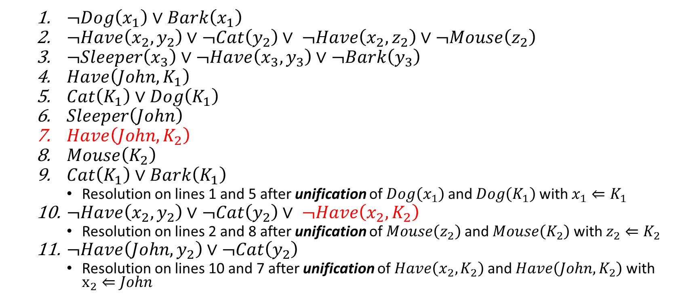
Resolution refutation
$¬Dog\left(x_{1}\right)∨Bark\left(x_{1}\right)$
$¬Have\left(x_{2},y_{2}\right)∨¬Cat\left(y_{2}\right)∨ ¬Have\left(x_{2},z_{2}\right)∨¬Mouse\left(z_{2}\right)$
$¬Sleeper\left(x_{3}\right)∨¬Have\left(x_{3},y_{3}\right)∨¬Bark\left(y_{3}\right)$
$Have\left(John,K_{1}\right)$
$Cat\left(K_{1}\right)∨Dog\left(K_{1}\right)$
$Sleeper\left(John\right)$
$Have\left(John,K_{2}\right)$
$Mouse\left(K_{2}\right)$
$Cat\left(K_{1}\right)∨Bark\left(K_{1}\right)$
Resolution on lines 1 and 5 after unification of $Dog\left(x_{1}\right)$ and $Dog\left(K_{1}\right)$ with $x_{1}⇐K_{1}$
$¬Have\left(x_{2},y_{2}\right)∨¬Cat\left(y_{2}\right)∨ ¬Have\left(x_{2},K_{2}\right)$
Resolution on lines 2 and 8 after unification of $Mouse\left(z_{2}\right)$ and $Mouse\left(K_{2}\right)$ with $z_{2}⇐K_{2}$
$¬Have\left(John,y_{2}\right)∨¬Cat\left(y_{2}\right)$
Resolution on lines 10 and 7 after unification of $Have\left(x_{2},K_{2}\right)$ and $Have\left(John,K_{2}\right)$ with $x_{2}⇐John$

Slide 52
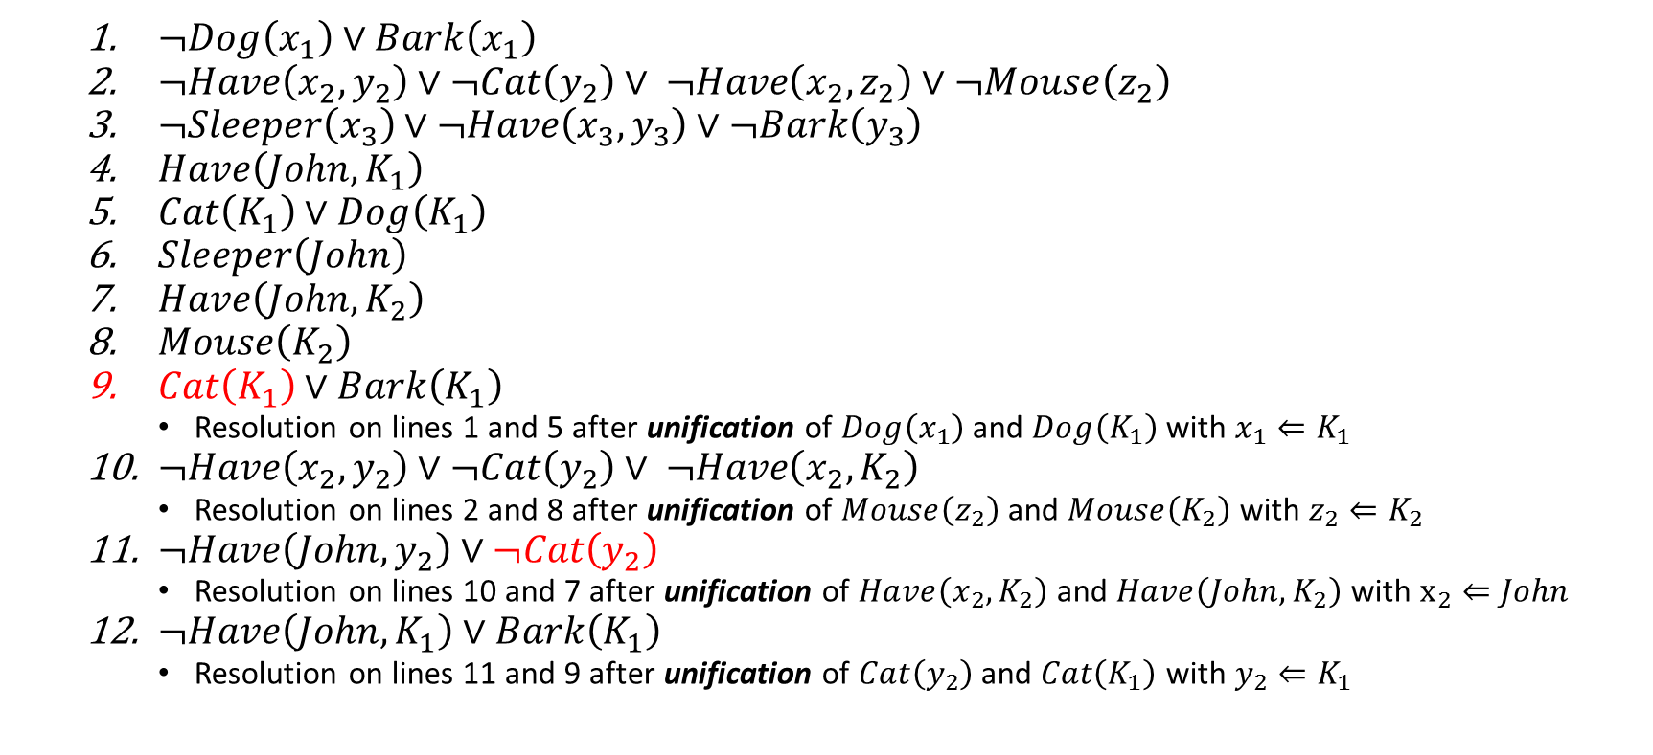
Resolution refutation
$¬Dog\left(x_{1}\right)∨Bark\left(x_{1}\right)$
$¬Have\left(x_{2},y_{2}\right)∨¬Cat\left(y_{2}\right)∨ ¬Have\left(x_{2},z_{2}\right)∨¬Mouse\left(z_{2}\right)$
$¬Sleeper\left(x_{3}\right)∨¬Have\left(x_{3},y_{3}\right)∨¬Bark\left(y_{3}\right)$
$Have\left(John,K_{1}\right)$
$Cat\left(K_{1}\right)∨Dog\left(K_{1}\right)$
$Sleeper\left(John\right)$
$Have\left(John,K_{2}\right)$
$Mouse\left(K_{2}\right)$
$Cat\left(K_{1}\right)∨Bark\left(K_{1}\right)$
Resolution on lines 1 and 5 after unification of $Dog\left(x_{1}\right)$ and $Dog\left(K_{1}\right)$ with $x_{1}⇐K_{1}$
$¬Have\left(x_{2},y_{2}\right)∨¬Cat\left(y_{2}\right)∨ ¬Have\left(x_{2},K_{2}\right)$
Resolution on lines 2 and 8 after unification of $Mouse\left(z_{2}\right)$ and $Mouse\left(K_{2}\right)$ with $z_{2}⇐K_{2}$
$¬Have\left(John,y_{2}\right)∨¬Cat\left(y_{2}\right)$
Resolution on lines 10 and 7 after unification of $Have\left(x_{2},K_{2}\right)$ and $Have\left(John,K_{2}\right)$ with $x_{2}⇐John$
$¬Have\left(John,K_{1}\right)∨Bark\left(K_{1}\right)$
Resolution on lines 11 and 9 after unification of $Cat\left(y_{2}\right)$ and $Cat\left(K_{1}\right)$ with $y_{2}⇐K_{1}$

Slide 53
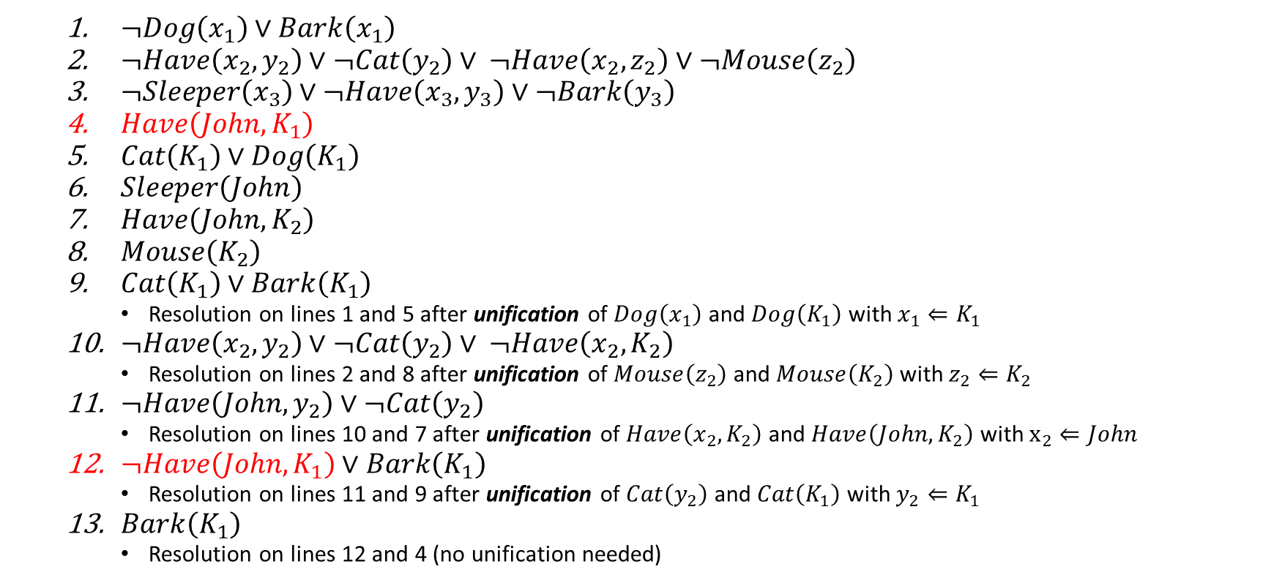
Resolution refutation
$¬Dog\left(x_{1}\right)∨Bark\left(x_{1}\right)$
$¬Have\left(x_{2},y_{2}\right)∨¬Cat\left(y_{2}\right)∨ ¬Have\left(x_{2},z_{2}\right)∨¬Mouse\left(z_{2}\right)$
$¬Sleeper\left(x_{3}\right)∨¬Have\left(x_{3},y_{3}\right)∨¬Bark\left(y_{3}\right)$
$Have\left(John,K_{1}\right)$
$Cat\left(K_{1}\right)∨Dog\left(K_{1}\right)$
$Sleeper\left(John\right)$
$Have\left(John,K_{2}\right)$
$Mouse\left(K_{2}\right)$
$Cat\left(K_{1}\right)∨Bark\left(K_{1}\right)$
Resolution on lines 1 and 5 after unification of $Dog\left(x_{1}\right)$ and $Dog\left(K_{1}\right)$ with $x_{1}⇐K_{1}$
$¬Have\left(x_{2},y_{2}\right)∨¬Cat\left(y_{2}\right)∨ ¬Have\left(x_{2},K_{2}\right)$
Resolution on lines 2 and 8 after unification of $Mouse\left(z_{2}\right)$ and $Mouse\left(K_{2}\right)$ with $z_{2}⇐K_{2}$
$¬Have\left(John,y_{2}\right)∨¬Cat\left(y_{2}\right)$
Resolution on lines 10 and 7 after unification of $Have\left(x_{2},K_{2}\right)$ and $Have\left(John,K_{2}\right)$ with $x_{2}⇐John$
$¬Have\left(John,K_{1}\right)∨Bark\left(K_{1}\right)$
Resolution on lines 11 and 9 after unification of $Cat\left(y_{2}\right)$ and $Cat\left(K_{1}\right)$ with $y_{2}⇐K_{1}$
$Bark\left(K_{1}\right)$
Resolution on lines 12 and 4 (no unification needed)

Slide 54
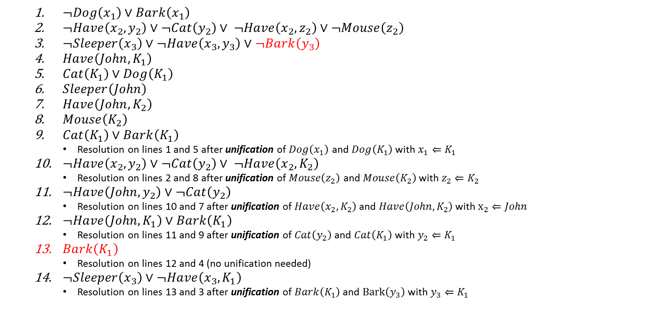
Resolution refutation
$¬Dog\left(x_{1}\right)∨Bark\left(x_{1}\right)$
$¬Have\left(x_{2},y_{2}\right)∨¬Cat\left(y_{2}\right)∨ ¬Have\left(x_{2},z_{2}\right)∨¬Mouse\left(z_{2}\right)$
$¬Sleeper\left(x_{3}\right)∨¬Have\left(x_{3},y_{3}\right)∨¬Bark\left(y_{3}\right)$
$Have\left(John,K_{1}\right)$
$Cat\left(K_{1}\right)∨Dog\left(K_{1}\right)$
$Sleeper\left(John\right)$
$Have\left(John,K_{2}\right)$
$Mouse\left(K_{2}\right)$
$Cat\left(K_{1}\right)∨Bark\left(K_{1}\right)$
Resolution on lines 1 and 5 after unification of $Dog\left(x_{1}\right)$ and $Dog\left(K_{1}\right)$ with $x_{1}⇐K_{1}$
$¬Have\left(x_{2},y_{2}\right)∨¬Cat\left(y_{2}\right)∨ ¬Have\left(x_{2},K_{2}\right)$
Resolution on lines 2 and 8 after unification of $Mouse\left(z_{2}\right)$ and $Mouse\left(K_{2}\right)$ with $z_{2}⇐K_{2}$
$¬Have\left(John,y_{2}\right)∨¬Cat\left(y_{2}\right)$
Resolution on lines 10 and 7 after unification of $Have\left(x_{2},K_{2}\right)$ and $Have\left(John,K_{2}\right)$ with $x_{2}⇐John$
$¬Have\left(John,K_{1}\right)∨Bark\left(K_{1}\right)$
Resolution on lines 11 and 9 after unification of $Cat\left(y_{2}\right)$ and $Cat\left(K_{1}\right)$ with $y_{2}⇐K_{1}$
$Bark\left(K_{1}\right)$
Resolution on lines 12 and 4 (no unification needed)
$¬Sleeper\left(x_{3}\right)∨¬Have\left(x_{3},K_{1}\right)$
Resolution on lines 13 and 3 after unification of $Bark\left(K_{1}\right)$ and $Bark\left(y_{3}\right)$ with $y_{3}⇐K_{1}$

Slide 55
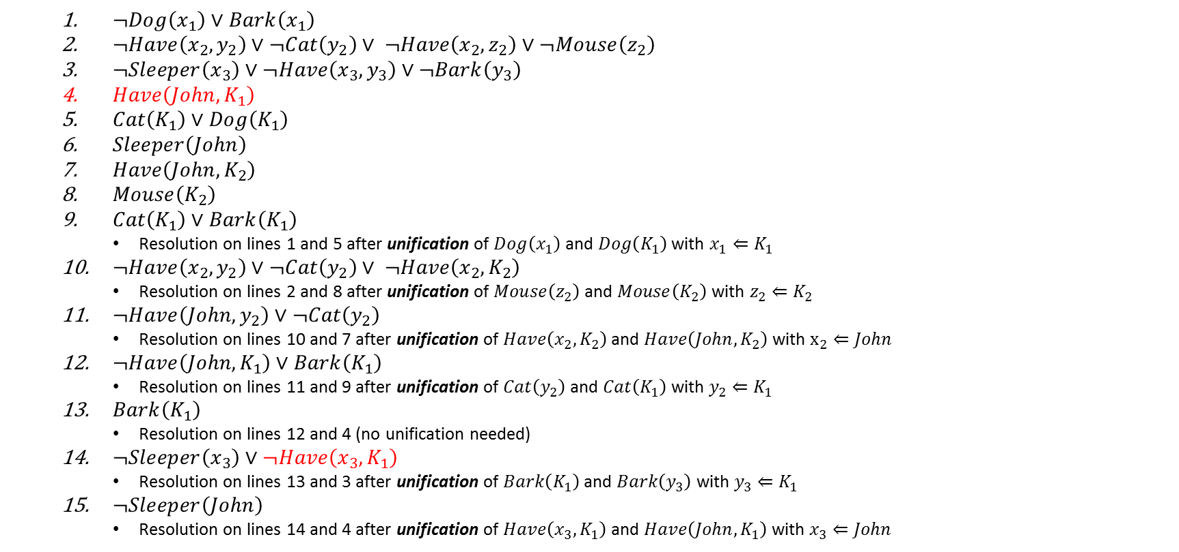
Resolution refutation
$¬Dog\left(x_{1}\right)∨Bark\left(x_{1}\right)$
$¬Have\left(x_{2},y_{2}\right)∨¬Cat\left(y_{2}\right)∨ ¬Have\left(x_{2},z_{2}\right)∨¬Mouse\left(z_{2}\right)$
$¬Sleeper\left(x_{3}\right)∨¬Have\left(x_{3},y_{3}\right)∨¬Bark\left(y_{3}\right)$
$Have\left(John,K_{1}\right)$
$Cat\left(K_{1}\right)∨Dog\left(K_{1}\right)$
$Sleeper\left(John\right)$
$Have\left(John,K_{2}\right)$
$Mouse\left(K_{2}\right)$
$Cat\left(K_{1}\right)∨Bark\left(K_{1}\right)$
Resolution on lines 1 and 5 after unification of $Dog\left(x_{1}\right)$ and $Dog\left(K_{1}\right)$ with $x_{1}⇐K_{1}$
$¬Have\left(x_{2},y_{2}\right)∨¬Cat\left(y_{2}\right)∨ ¬Have\left(x_{2},K_{2}\right)$
Resolution on lines 2 and 8 after unification of $Mouse\left(z_{2}\right)$ and $Mouse\left(K_{2}\right)$ with $z_{2}⇐K_{2}$
$¬Have\left(John,y_{2}\right)∨¬Cat\left(y_{2}\right)$
Resolution on lines 10 and 7 after unification of $Have\left(x_{2},K_{2}\right)$ and $Have\left(John,K_{2}\right)$ with $x_{2}⇐John$
$¬Have\left(John,K_{1}\right)∨Bark\left(K_{1}\right)$
Resolution on lines 11 and 9 after unification of $Cat\left(y_{2}\right)$ and $Cat\left(K_{1}\right)$ with $y_{2}⇐K_{1}$
$Bark\left(K_{1}\right)$
Resolution on lines 12 and 4 (no unification needed)
$¬Sleeper\left(x_{3}\right)∨¬Have\left(x_{3},K_{1}\right)$
Resolution on lines 13 and 3 after unification of $Bark\left(K_{1}\right)$ and $Bark\left(y_{3}\right)$ with $y_{3}⇐K_{1}$
$¬Sleeper\left(John\right)$
Resolution on lines 14 and 4 after unification of $Have\left(x_{3},K_{1}\right)$ and $Have\left({John,K}_{1}\right)$ with $x_{3}⇐John$

Slide 56
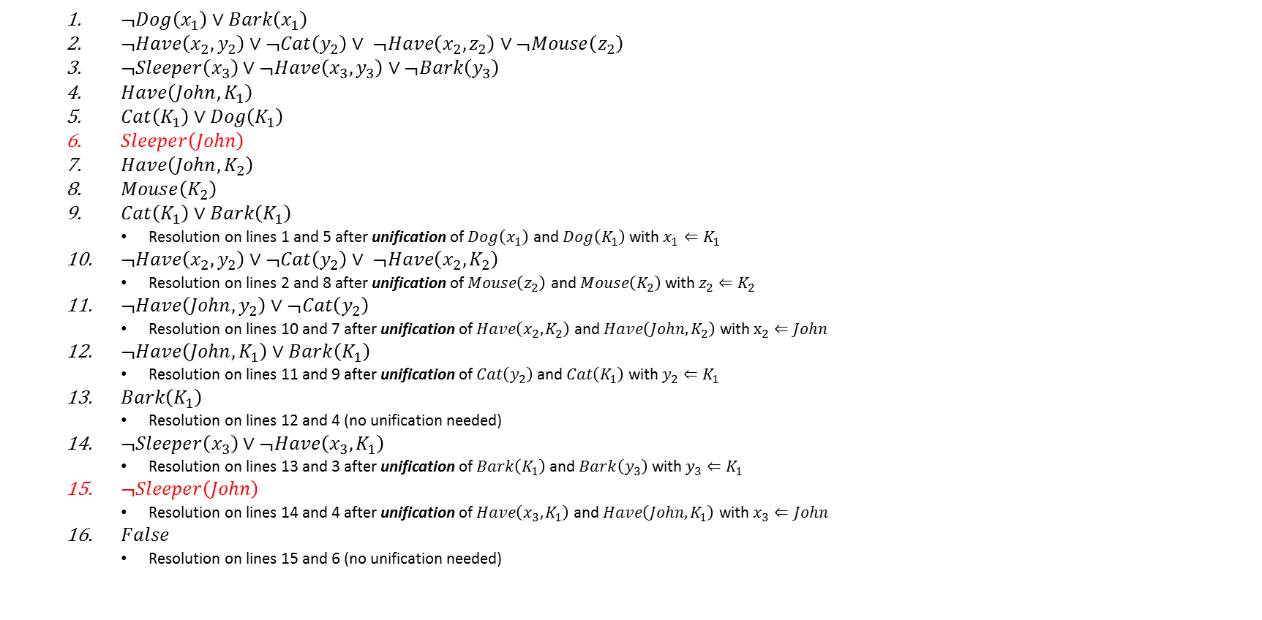
Resolution refutation
$¬Dog\left(x_{1}\right)∨Bark\left(x_{1}\right)$
$¬Have\left(x_{2},y_{2}\right)∨¬Cat\left(y_{2}\right)∨ ¬Have\left(x_{2},z_{2}\right)∨¬Mouse\left(z_{2}\right)$
$¬Sleeper\left(x_{3}\right)∨¬Have\left(x_{3},y_{3}\right)∨¬Bark\left(y_{3}\right)$
$Have\left(John,K_{1}\right)$
$Cat\left(K_{1}\right)∨Dog\left(K_{1}\right)$
$Sleeper\left(John\right)$
$Have\left(John,K_{2}\right)$
$Mouse\left(K_{2}\right)$
$Cat\left(K_{1}\right)∨Bark\left(K_{1}\right)$
Resolution on lines 1 and 5 after unification of $Dog\left(x_{1}\right)$ and $Dog\left(K_{1}\right)$ with $x_{1}⇐K_{1}$
$¬Have\left(x_{2},y_{2}\right)∨¬Cat\left(y_{2}\right)∨ ¬Have\left(x_{2},K_{2}\right)$
Resolution on lines 2 and 8 after unification of $Mouse\left(z_{2}\right)$ and $Mouse\left(K_{2}\right)$ with $z_{2}⇐K_{2}$
$¬Have\left(John,y_{2}\right)∨¬Cat\left(y_{2}\right)$
Resolution on lines 10 and 7 after unification of $Have\left(x_{2},K_{2}\right)$ and $Have\left(John,K_{2}\right)$ with $x_{2}⇐John$
$¬Have\left(John,K_{1}\right)∨Bark\left(K_{1}\right)$
Resolution on lines 11 and 9 after unification of $Cat\left(y_{2}\right)$ and $Cat\left(K_{1}\right)$ with $y_{2}⇐K_{1}$
$Bark\left(K_{1}\right)$
Resolution on lines 12 and 4 (no unification needed)
$¬Sleeper\left(x_{3}\right)∨¬Have\left(x_{3},K_{1}\right)$
Resolution on lines 13 and 3 after unification of $Bark\left(K_{1}\right)$ and $Bark\left(y_{3}\right)$ with $y_{3}⇐K_{1}$
$¬Sleeper\left(John\right)$
Resolution on lines 14 and 4 after unification of $Have\left(x_{3},K_{1}\right)$ and $Have\left({John,K}_{1}\right)$ with $x_{3}⇐John$
$False$
Resolution on lines 15 and 6 (no unification needed)

Slide 57
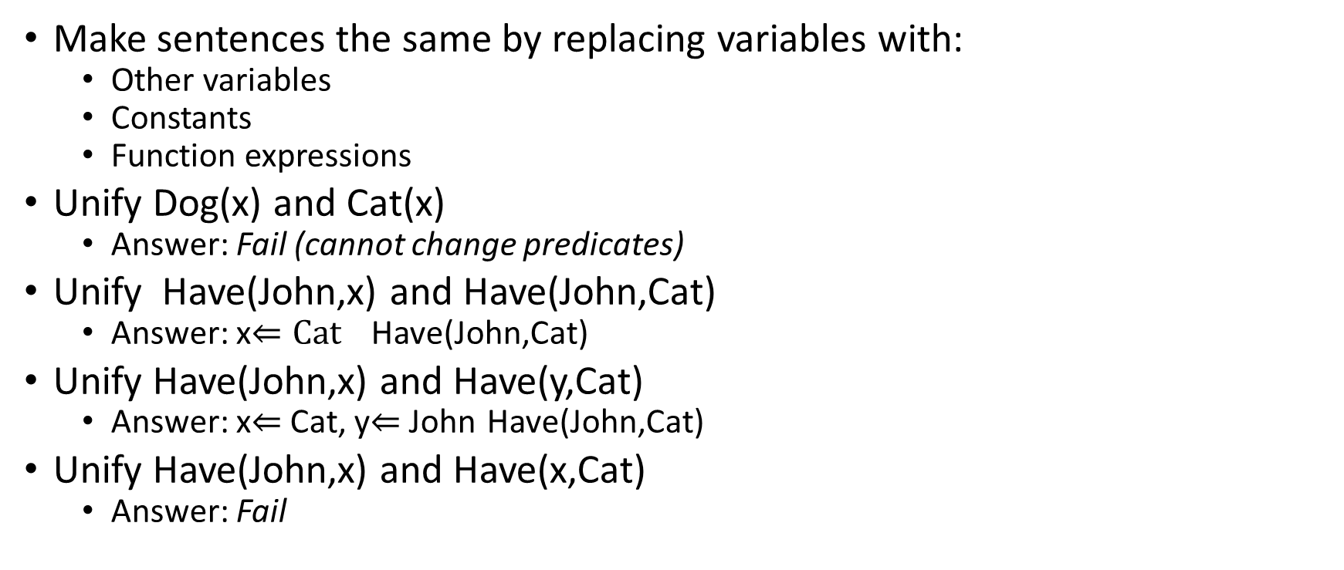
Unification
Make sentences the same by replacing variables with:
Other variables
Constants
Function expressions
Unify Dog(x) and Cat(x)
Answer: Fail (cannot change predicates)
Unify Have(John,x) and Have(John,Cat)
Answer: x$⇐Cat$ Have(John,Cat)
Unify Have(John,x) and Have(y,Cat)
Answer: x$⇐$Cat, y$⇐$John Have(John,Cat)
Unify Have(John,x) and Have(x,Cat)
Answer: Fail

Slide 58
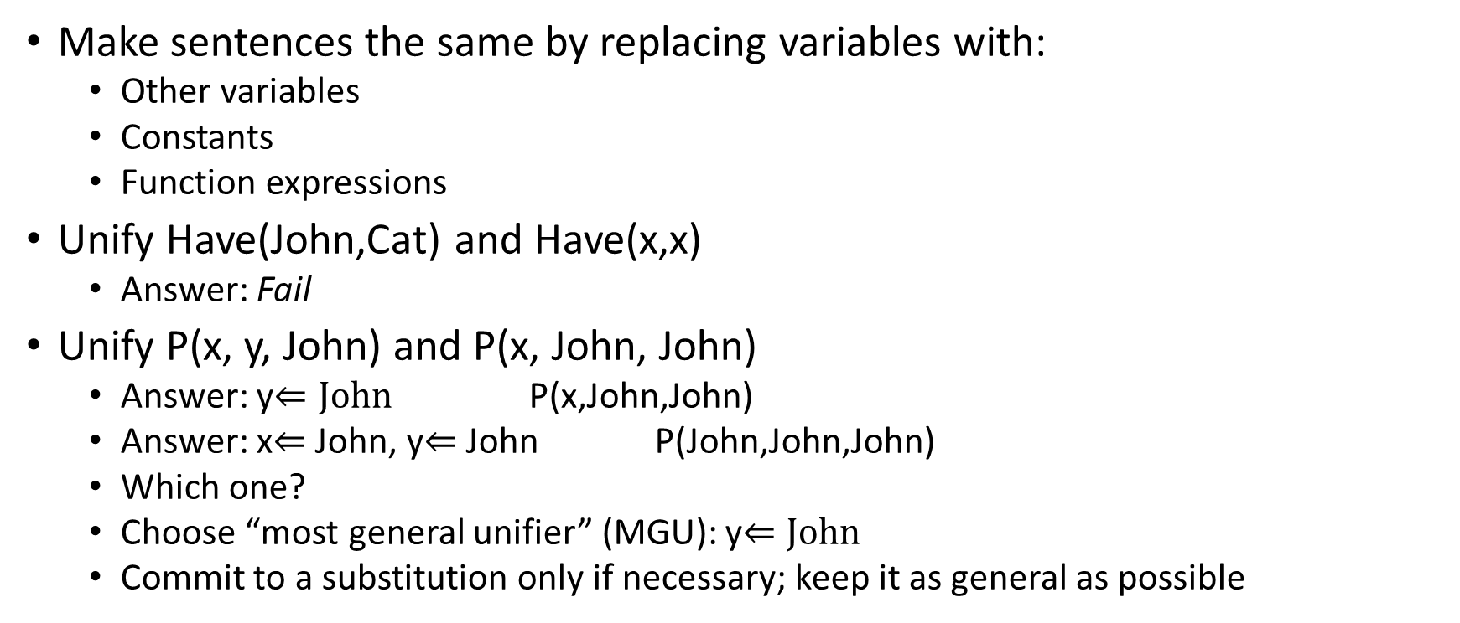
Unification
Make sentences the same by replacing variables with:
Other variables
Constants
Function expressions
Unify Have(John,Cat) and Have(x,x)
Answer: Fail
Unify P(x, y, John) and P(x, John, John)
Answer: y$⇐John$ P(x,John,John)
Answer: x$⇐$John, y$⇐$John P(John,John,John)
Which one?
Choose “most general unifier” (MGU): y$⇐John$
Commit to a substitution only if necessary; keep it as general as possible

Slide 59
Unification algorithm
Input
A pair of predicate logic expressions
Output
Most General Unifier (MGU) if possible
Fail otherwise
Recursive algorithm
Represent the expression as a list
Process the list from the head
Determine a substitution to the head of the list
Apply substitution to the rest of the list
Recurse on the rest of the list

Slide 60
Recursive definitions in predicate logic
Example: define the ancestor predicate
∀x ∀y parent(x, y) → ancestor(x, y)
∀x ∀y ∃z parent(x, z) ∧ ancestor(z, y) → ancestor(x, y)

Slide 61
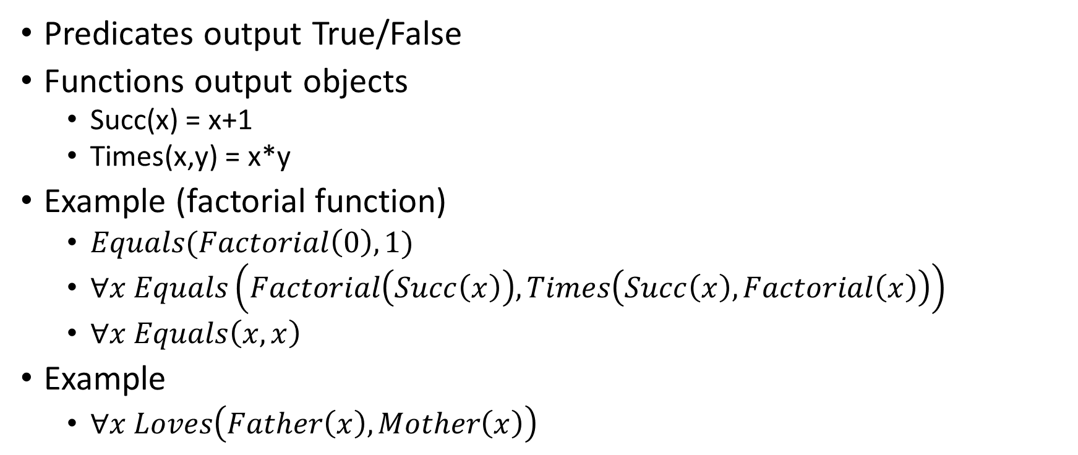
Functions in predicate logic
Predicates output True/False
Functions output objects
Succ(x) = x+1
Times(x,y) = x*y
Example (factorial function)
$Equals(Factorial\left(0\right), 1)$
$∀x Equals\left(Factorial\left(Succ\left(x\right)\right), Times\left(Succ\left(x\right),Factorial\left(x\right)\right)\right)$
$∀x Equals\left(x,x\right)$
Example
$∀x Loves\left(Father\left(x\right),Mother\left(x\right)\right)$

Slide 62
Resolution with functions
Premise
John hates everyone he knows
Everyone knows their mother
Conclusion?
John hates his mother

Slide 63
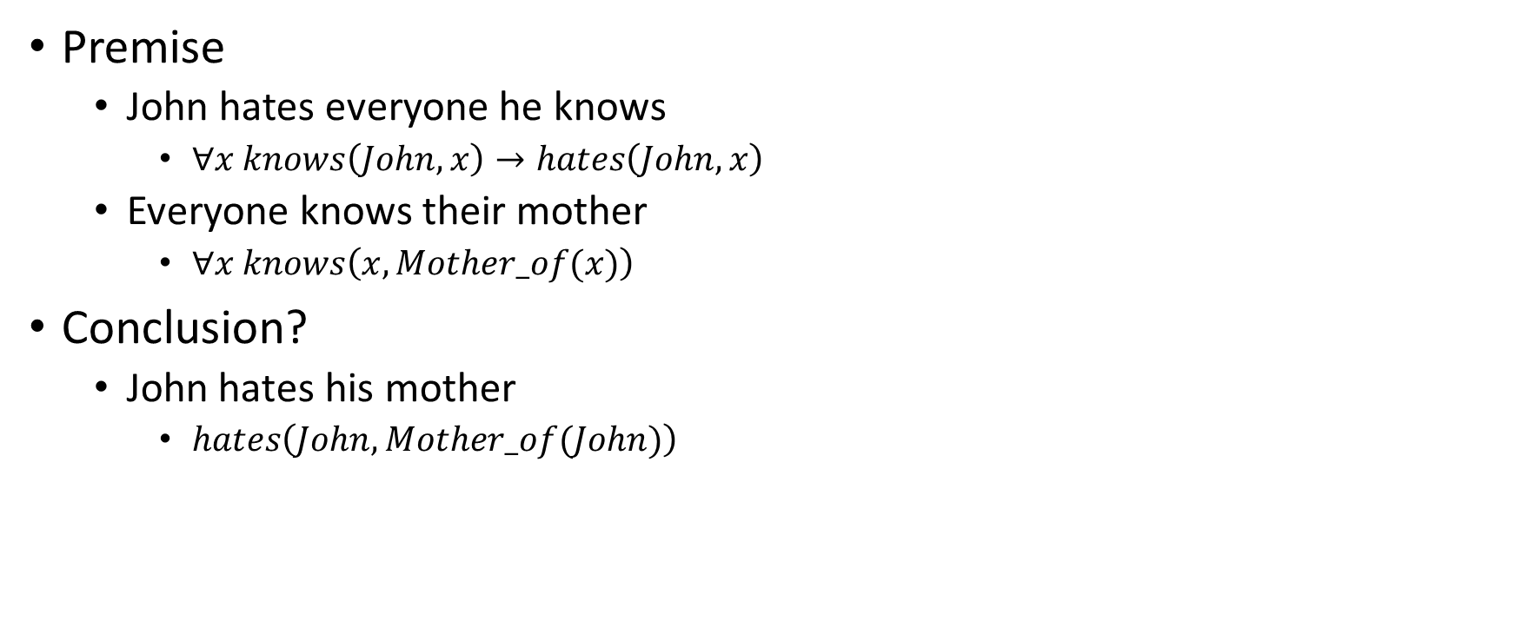
Resolution with functions
Premise
John hates everyone he knows
$∀x knows\left(John,x\right)→hates\left(John,x\right)$
Everyone knows their mother
$∀x knows\left(x,Mother_of(x)\right)$
Conclusion?
$\text{John} \text{hates} \text{his} \text{mother}$
$hates\left(John,Mother_of(John)\right)$

Slide 64
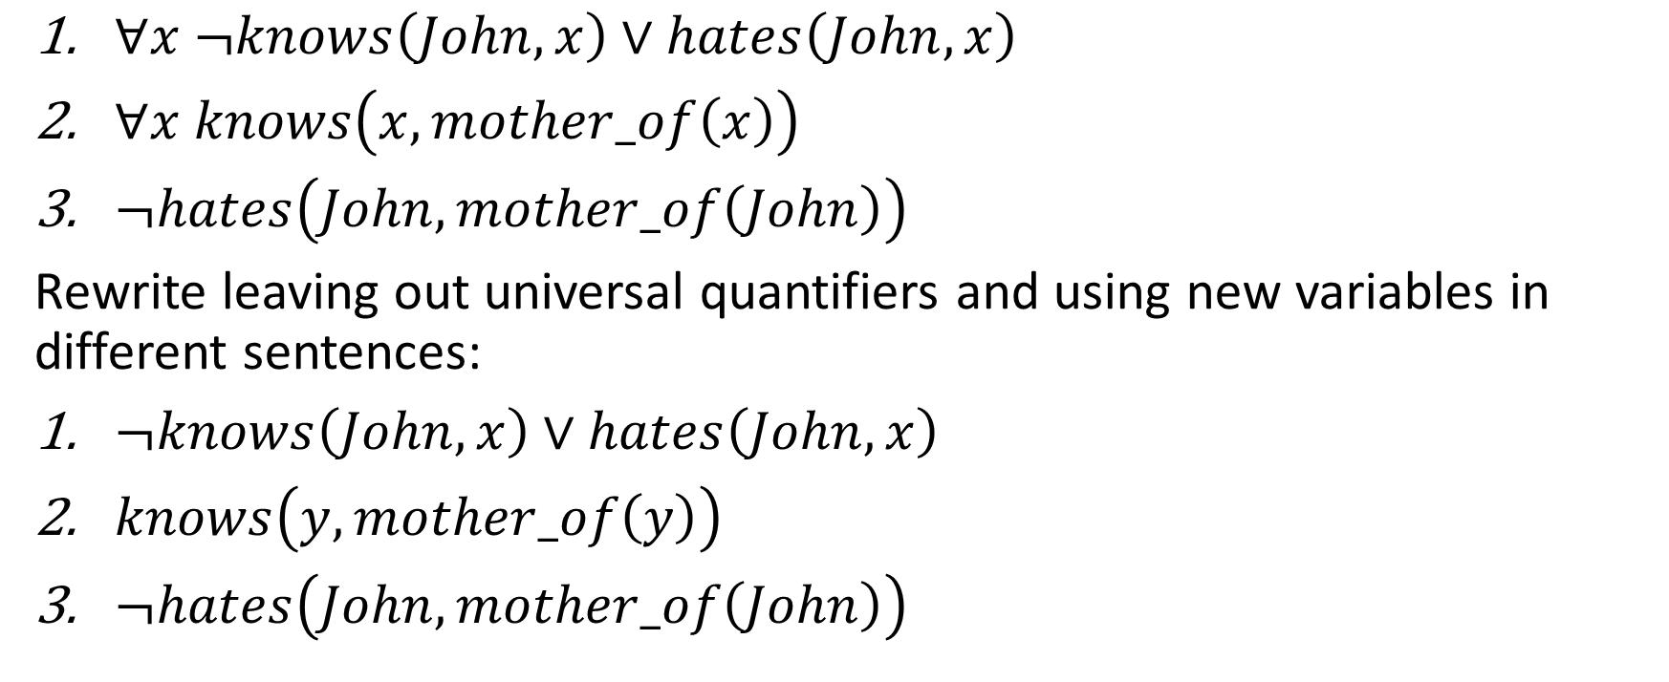
Resolution with functions
$∀x ¬knows\left(John,x\right)∨hates\left(John,x\right)$
$∀x knows\left(x,mother_of\left(x\right)\right)$
$¬hates\left(John,mother_of\left(John\right)\right)$
Rewrite leaving out universal quantifiers and using new variables in different sentences:
$¬knows\left(John,x\right)∨hates\left(John,x\right)$
$knows\left(y,mother_of\left(y\right)\right)$
$¬hates\left(John,mother_of\left(John\right)\right)$

Slide 65
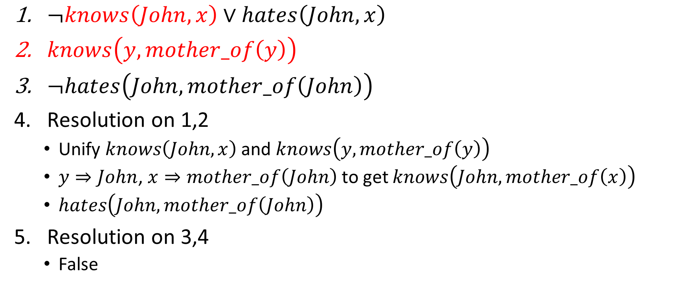
Resolution with functions
$¬knows\left(John,x\right)∨hates\left(John,x\right)$
$knows\left(y,mother_of\left(y\right)\right)$
$¬hates\left(John,mother_of\left(John\right)\right)$
Resolution on 1,2
Unify $knows\left(John,x\right)$ and $knows\left(y,mother_of\left(y\right)\right)$
$y⇒John$, $x⇒mother_of\left(John\right)$ to get $knows\left(John,mother_of\left(x\right)\right)$
$hates\left(John,mother_of\left(John\right)\right)$
Resolution on 3,4
False

Slide 66
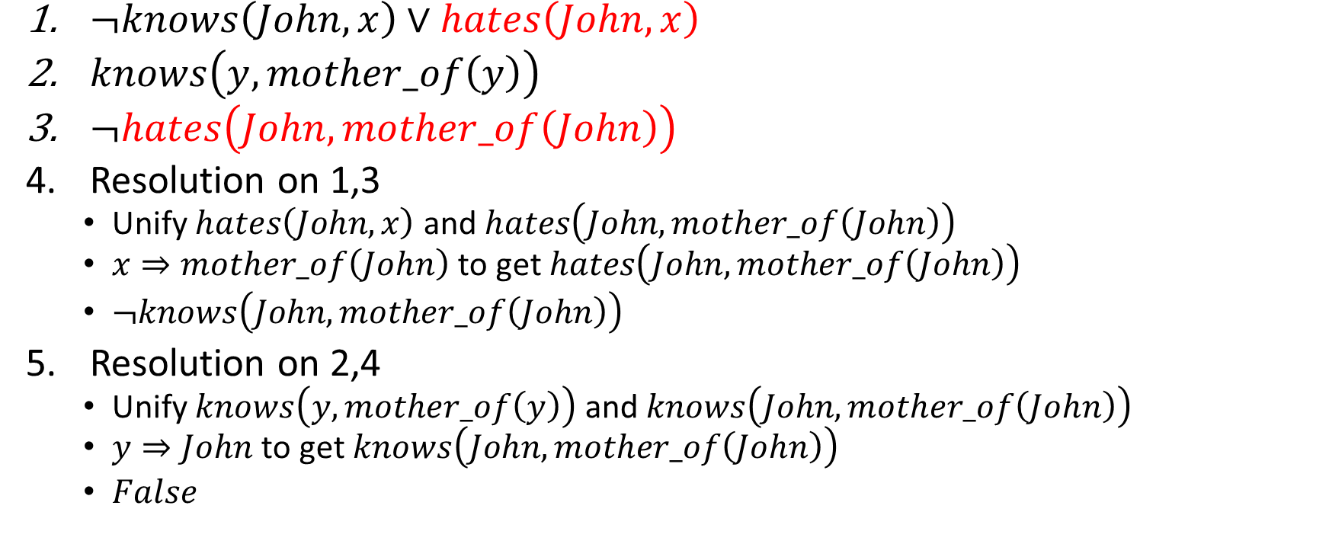
Resolution with functions
$¬knows\left(John,x\right)∨hates\left(John,x\right)$
$knows\left(y,mother_of\left(y\right)\right)$
$¬hates\left(John,mother_of\left(John\right)\right)$
Resolution on 1,3
Unify $hates\left(John,x\right)$ and $hates\left(John,mother_of\left(John\right)\right)$
$x⇒mother_of\left(John\right)$ to get $hates\left(John,mother_of\left(John\right)\right)$
$¬knows\left(John,mother_of\left(John\right)\right)$
Resolution on 2,4
Unify $knows\left(y,mother_of\left(y\right)\right)$ and $knows\left(John,mother_of\left(John\right)\right)$
$y⇒John$ to get $knows\left(John,mother_of\left(John\right)\right)$
$False$

Slide 67
Unification algorithm
Input
A pair of predicate logic expressions
Output
Most General Unifier (MGU) if possible
Fail otherwise
Recursive algorithm
Represent the expression as a list
Process the list from the head
Determine a substitution to the head of the list
Apply substitution to the rest of the list
Recurse on the rest of the list

Slide 68
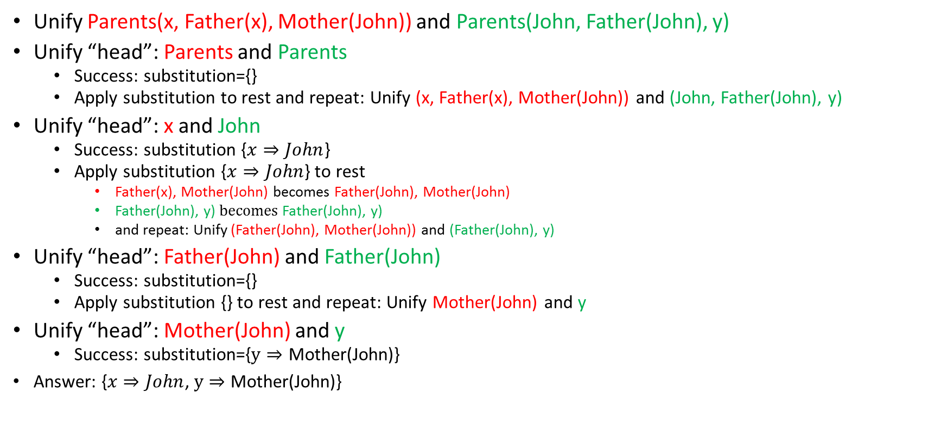
Unification algorithm example
Unify Parents(x, Father(x), Mother(John)) and Parents(John, Father(John), y)
Unify “head”: Parents and Parents
Success: substitution={}
Apply substitution to rest and repeat: Unify (x, Father(x), Mother(John)) and (John, Father(John), y)
Unify “head”: x and John
Success: substitution {$x⇒John$}
Apply substitution {$x⇒John$} to rest
Father(x), Mother(John) becomes Father(John), Mother(John)
Father(John), y) $becomes$Father(John), y)
and repeat: Unify (Father(John), Mother(John)) and (Father(John), y)
Unify “head”: Father(John) and Father(John)
Success: substitution={}
Apply substitution {} to rest and repeat: Unify Mother(John) and y
Unify “head”: Mother(John) and y
Success: substitution={$y⇒$ Mother(John)}
Answer: {$x⇒John$, $y⇒$ Mother(John)}

Slide 69
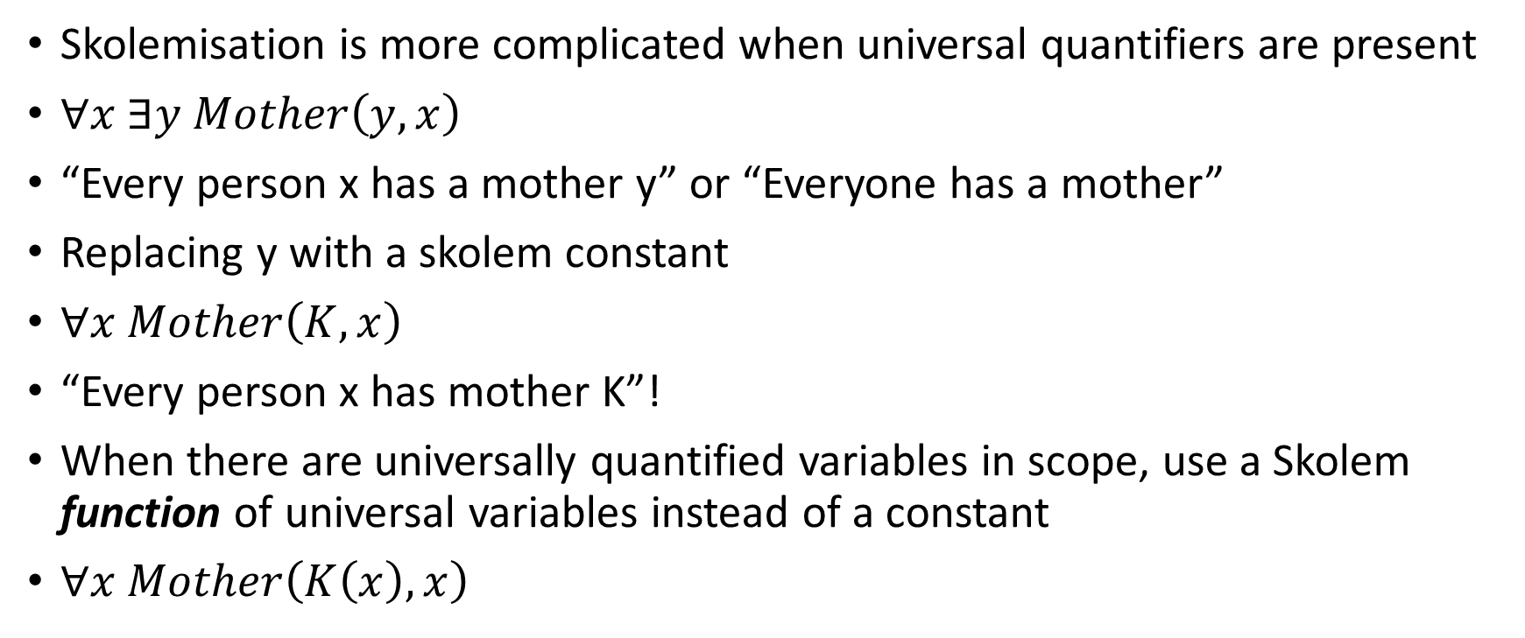
Skolemisation
Skolemisation is more complicated when universal quantifiers are present
$∀x ∃y Mother\left(y,x\right)$
“Every person x has a mother y” or “Everyone has a mother”
Replacing y with a skolem constant
$∀x Mother\left(K,x\right)$
“Every person x has mother K”!
When there are universally quantified variables in scope, use a Skolem function of universal variables instead of a constant
$∀x Mother\left(K\left(x\right),x\right)$

Slide 70
Logically follows and Inference
Logically follows (“entailment”)
Is the sentence true for all variable assignments to the premises
Inference
A sentence derived from an existing set of sentences by repeated application of rules

Slide 71
Soundness
An inference rule is sound if
all predicate calculus expressions produced using the inference rule from a set of expressions, S, logically follow from S
Resolution is sound

Slide 72
Completeness
An inference rule is complete if given a set S of predicate calculus expressions, it can infer every expression that logically follows from S
Predicate logic is refutation complete
Can use resolution to prove that a given sentence Q logically follows from the premises, but
in general cannot be used to generate all logical consequences of the premises

Slide 73
Decidability
Resolution cannot be used to prove that Q does not follow from the premises
Resolution refutation terminates by generating False if Q follows from premises, but it may never terminate if Q does not follow from premises
Predicate logic is only semi-decidable

Slide 74
Higher-order logics
Predicate logic (first order logic) only allows to quantify over variables, and variables can only range over objects.
Higher order logics can quantify over predicates and functions
∀r transitive( r ) → ∀x ∀y ∀z) r(x,y) ∧ r(y,z) → r(x,z)
“two functions are equal iff they produce the same value for all arguments”
∀f ∀g Equals(f, g) ↔ (∀x Equals(f(x), g(x))
More expressive, but undecidable
There isn’t an algorithm to decide whether all sentences are valid

Slide 75
Summary
Propositional calculus (0th order): no variables or functions
Predicate calculus (1st order): allows quantified variables as parameters of predicates or functions
Higher order logics: allows predicates to be variables

Slide 76
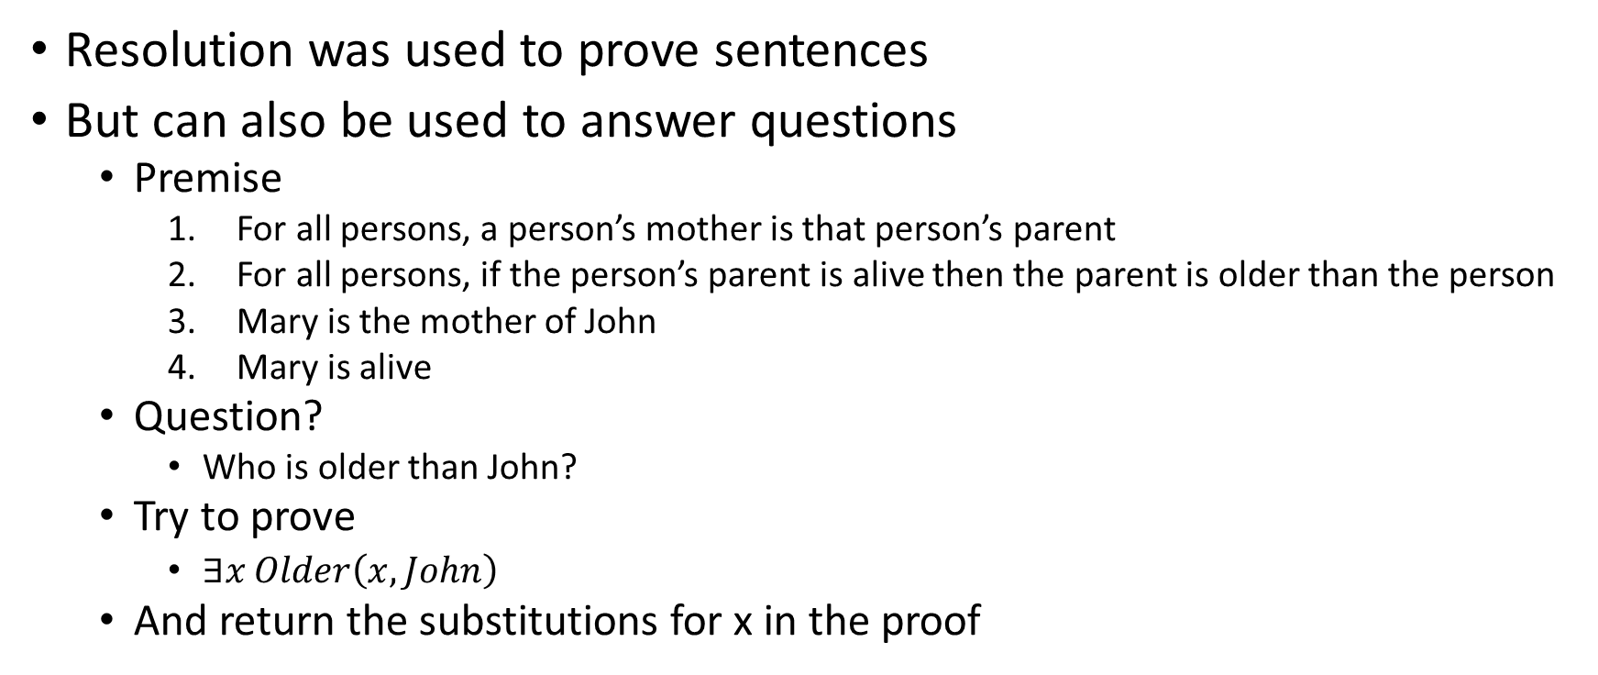
Question Answering
Resolution was used to prove sentences
But can also be used to answer questions
Premise
For all persons, a person’s mother is that person’s parent
For all persons, if the person’s parent is alive then the parent is older than the person
Mary is the mother of John
Mary is alive
Question?
Who is older than John?
Try to prove
$∃x Older\left(x,John\right)$
And return the substitutions for x in the proof

Slide 77
Expressing uniqueness
To define a single, unique object that satisfies a condition
“There exists a unique x such that king(x) is true”
∃x king(x) ∧ ∀y king(y) → Equals(x,y)
∃! x king(x)
“Every country has exactly one ruler”
∀c country(c) → ∃! r ruler(c,r)

Slide 78
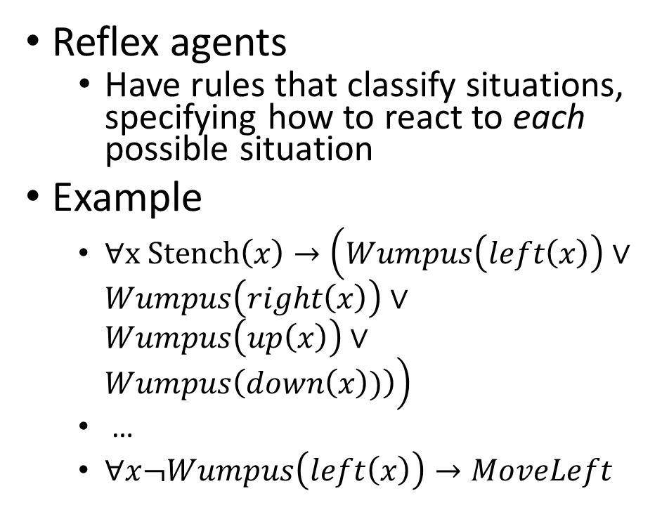
How to represent actions?
Reflex agents
Have rules that classify situations, specifying how to react to each possible situation
Example
$∀x Stench\left(x\right)→\left(Wumpus\left(left\left(x\right)\right)∨Wumpus\left(right\left(x\right)\right)∨Wumpus\left(up\left(x\right)\right)∨Wumpus\left(down\left(x\right))\right)\right)$
…
$∀x¬Wumpus\left(left\left(x\right)\right)→MoveLeft$

Slide 79
Reflex actions
Advantage
Fast!
Useful in robotics
Disadvantages
Loops – the observations will be repeated when agent returns to a square
Results in same response
Need to maintain some internal model of how the world changes because of actions

Slide 80
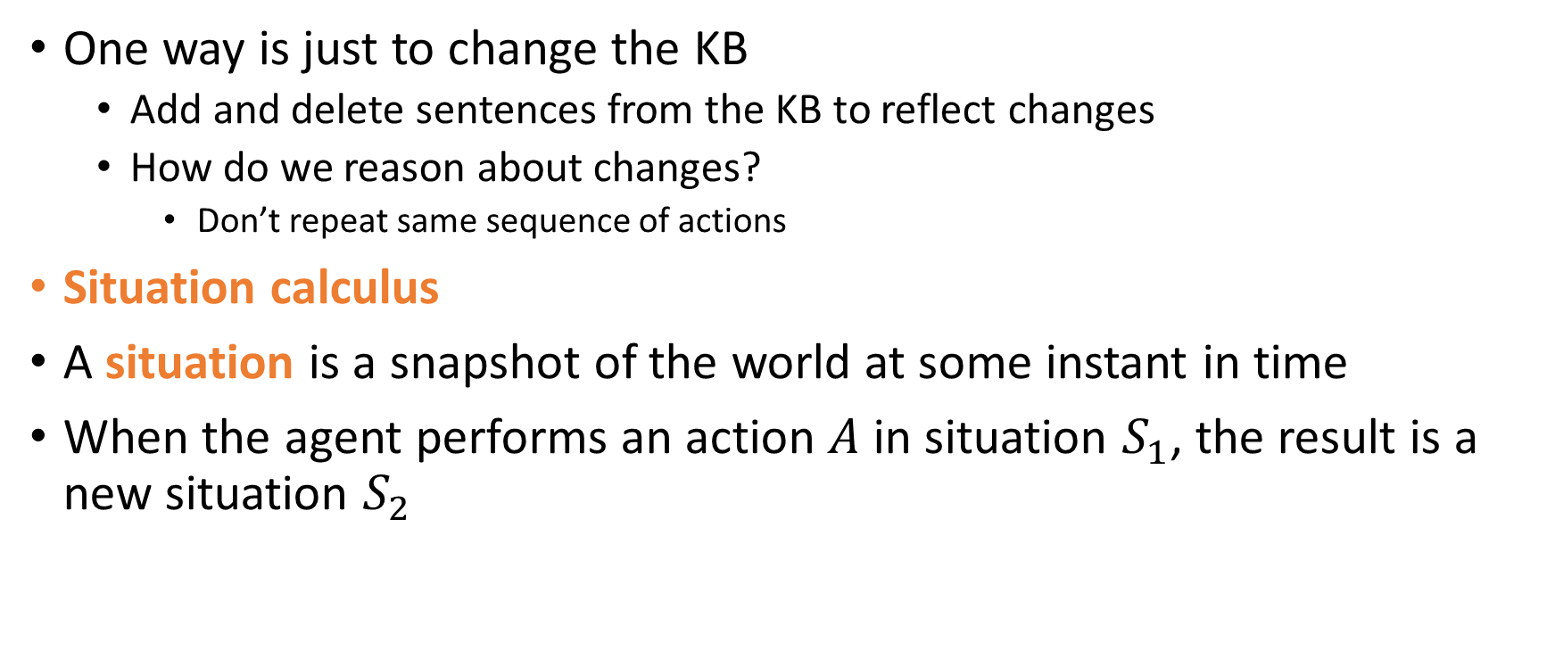
Representing change
One way is just to change the KB
Add and delete sentences from the KB to reflect changes
How do we reason about changes?
Don’t repeat same sequence of actions
Situation calculus
A situation is a snapshot of the world at some instant in time
When the agent performs an action $A$ in situation $S_{1}$, the result is a new situation $S_{2}$

Slide 81
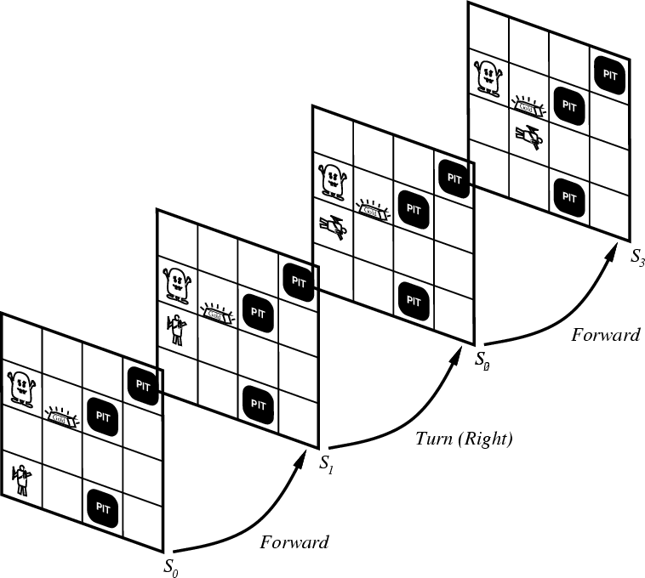
Situations

Slide 82
Situation Calculus
Situation Calculus was introduced by John McCarthy in 1969
It describes dynamic domains in Predicate Logic using
situations (denote world states; include world history)
actions (functions)
axioms (to specify actions and domain knowledge)
Planning of actions in the situation calculus is done through theorem proving
Infer a goal situation from the initial situation using the given axioms

Slide 83
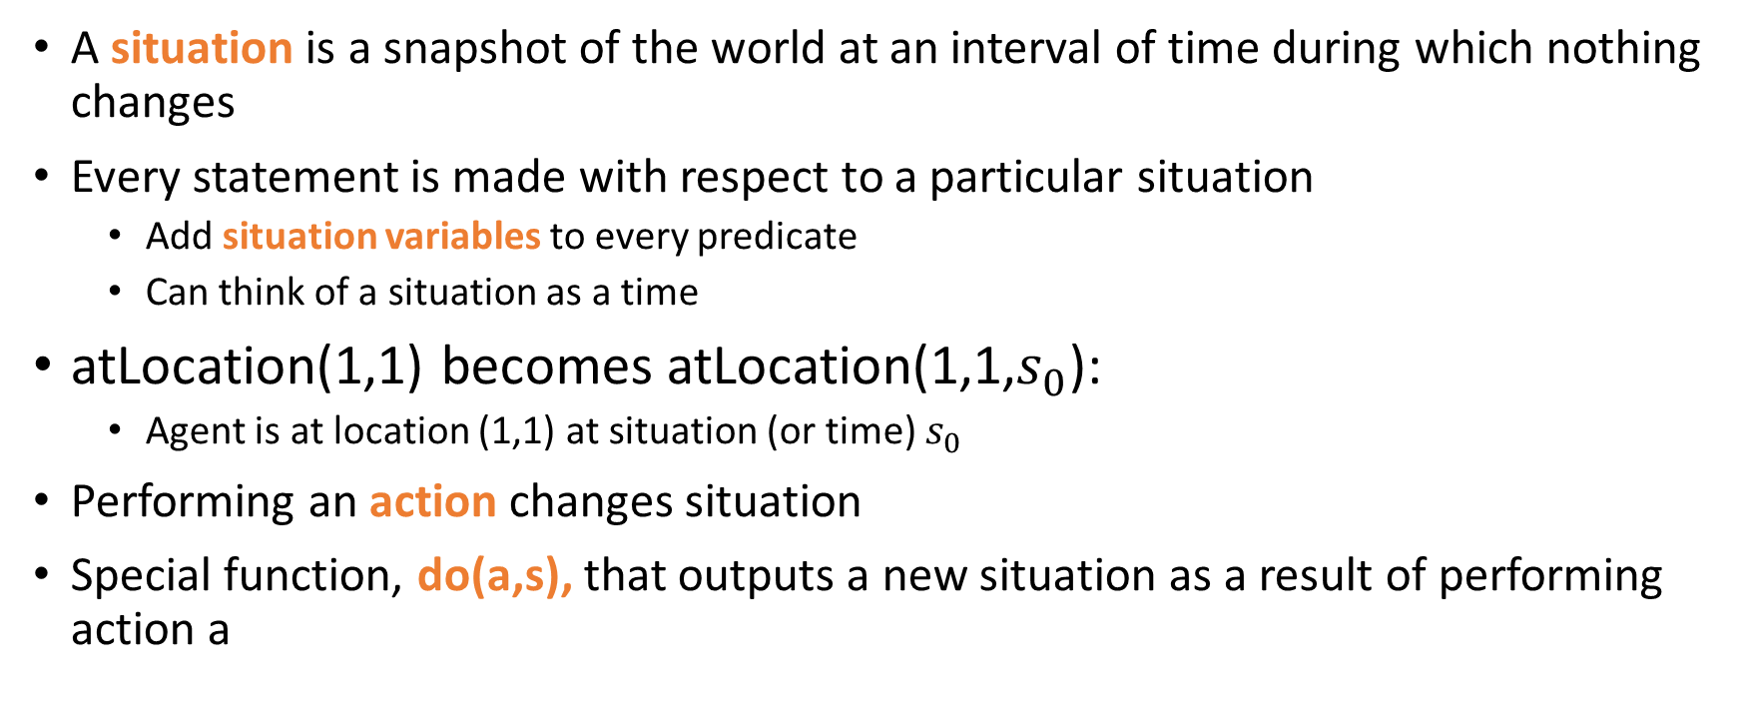
Situation calculus
A situation is a snapshot of the world at an interval of time during which nothing changes
Every statement is made with respect to a particular situation
Add situation variables to every predicate
Can think of a situation as a time
atLocation(1,1) becomes atLocation(1,1,$s_{0}$):
Agent is at location (1,1) at situation (or time) $s_{0}$
Performing an action changes situation
Special function, do(a,s), that outputs a new situation as a result of performing action a

Slide 84
Situation Calculus: example
World:
robot
Items (e.g., Ball)
locations (x,y)
Robot moves around the world by specifying target location
picks up or drops items
some items are too heavy for the robot to pick up
some items are fragile so that they break when they are dropped

Slide 85
Situation Calculus: example
Actions
move(x, y): robot is moving to a new location (x, y)
pickup(o): robot picks up an object o
drop(o): robot drops the object o that holds

Slide 86
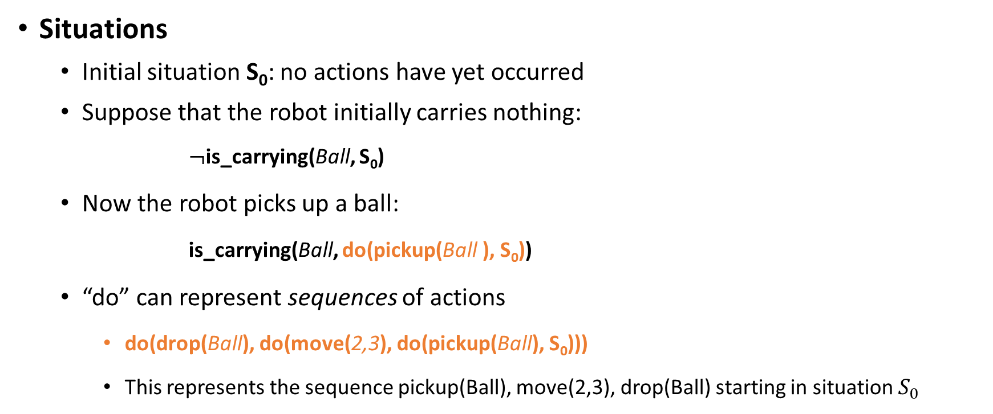
Situation Calculus
Situations
Initial situation S₀: no actions have yet occurred
Suppose that the robot initially carries nothing:
$¬$is_carrying(Ball, S₀)
Now the robot picks up a ball:
is_carrying(Ball, do(pickup(Ball ), S₀))
“do” can represent sequences of actions
do(drop(Ball), do(move(2,3), do(pickup(Ball), S₀)))
This represents the sequence pickup(Ball), move(2,3), drop(Ball) starting in situation $S_{0}$
The new situation

Slide 87
Situation Calculus
is_carrying(Ball,s)
A fluent: represents a property of the world
Predicate logic statements whose truth value may change
They take a situation as a final argument

Slide 88
Situation Calculus
Actions have preconditions
Not all actions can be performed in a situation
Precondition Axioms
Precondition(drop(o),s) ↔ is_carrying(o,s)
Precondition(pickup(o),s) ↔ (∀z ¬is_carrying(z,s) ∧¬heavy(o))

Slide 89
Situation Calculus
Actions have post-conditions (effects)
pickup(o) in s
is_carrying(o,do(pickup(o),s))
drop(o) in s ∧ fragile(o)
broken(o,do( drop(o),s))

Slide 90
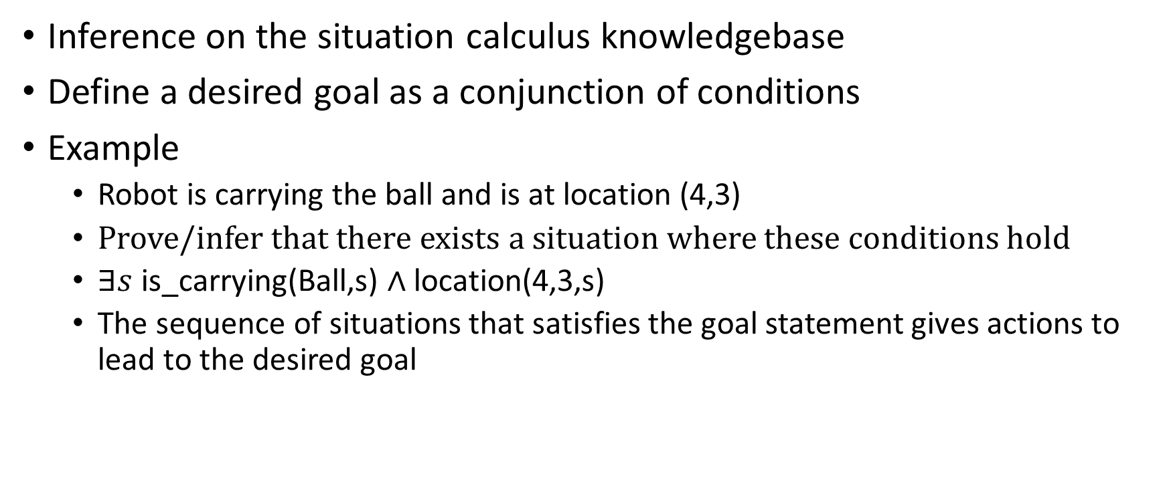
Planning a sequence of actions
Inference on the situation calculus knowledgebase
Define a desired goal as a conjunction of conditions
Example
Robot is carrying the ball and is at location (4,3)
Prove/infer that there exists a situation where these conditions hold
$∃s$is_carrying(Ball,s) $∧$ location(4,3,s)
The sequence of situations that satisfies the goal statement gives actions to lead to the desired goal

Slide 91
Problems with inference-based planning
Solution can contain irrelevant actions
Inference is slow
Resolution refutation
Practical planners restrict the language used to represent the problem
Action Languages
STRIPS
Planning as search in state space

Slide 92
The frame problem
How to specify that all conditions not affected by an action are not changed while executing that action?
In predicate logic, all such static properties need to be explicitly specified for every possible action
Frame axioms
Example:
If robot moves to (x,y) and is not holding a ball, then the location of the ball does not change
What is the problem?
A very large number of frame axioms is often necessary

Slide 93
Qualification problem
How to define every possible precondition of an action
Including exceptions that might occur
Example
When robot picks up the ball, it will hold the ball unless
The robot battery runs out, or
The gripper slips, or
The ball rolls away, or
Another robot picks the ball first, or …

Slide 94
Ramification problem
How to define every possible effect of an action
Example
When robot picks up the ball, all of these are possible
The battery drains a little bit, and
The gripper is closed, and
The ball does not roll, and
No other robot holds the ball, and …

Slide 95
Knowledge engineering
Modeling the “right” conditions and the “right” effects at the “right” level of abstraction is difficult
Automated knowledge acquisition and machine learning
Intelligent systems should be able to learn about the conditions and effects
Learn from?
Data: sensor measurements (of both causes and effects)

